Slide 1

Welcome to Reception
Penguins and Puffins Class

Slide 2
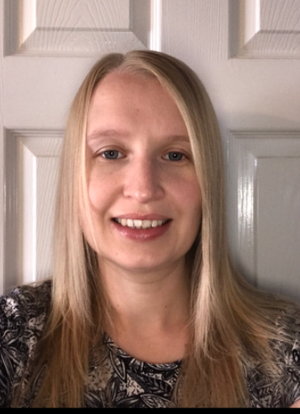
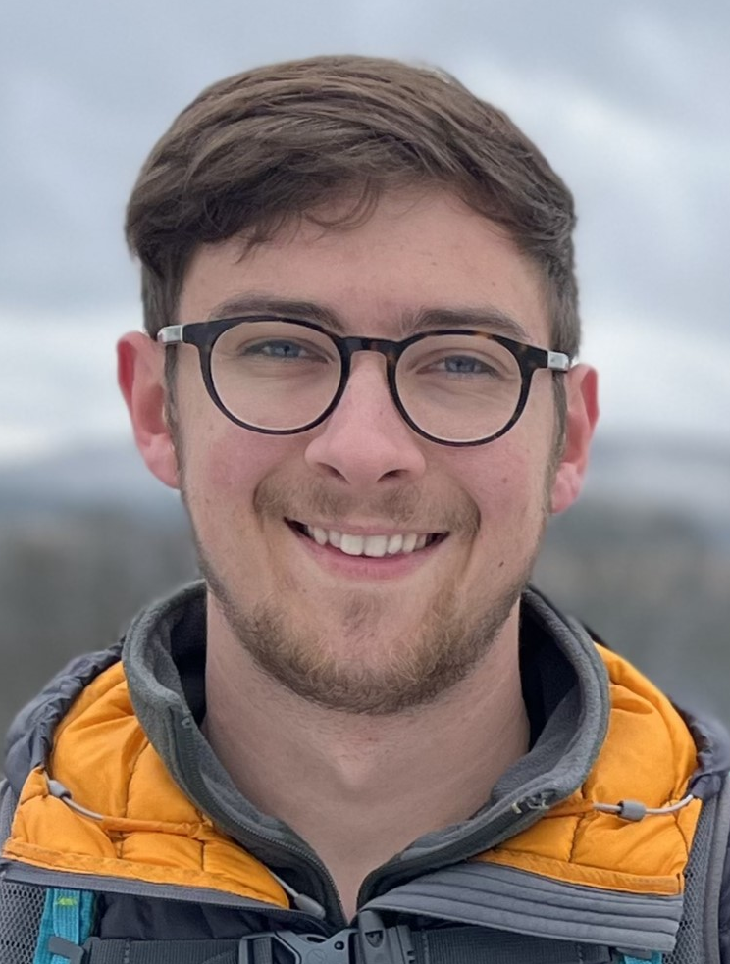
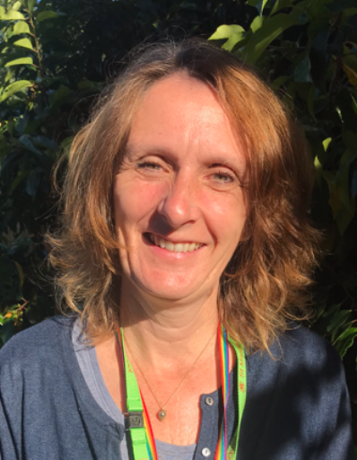
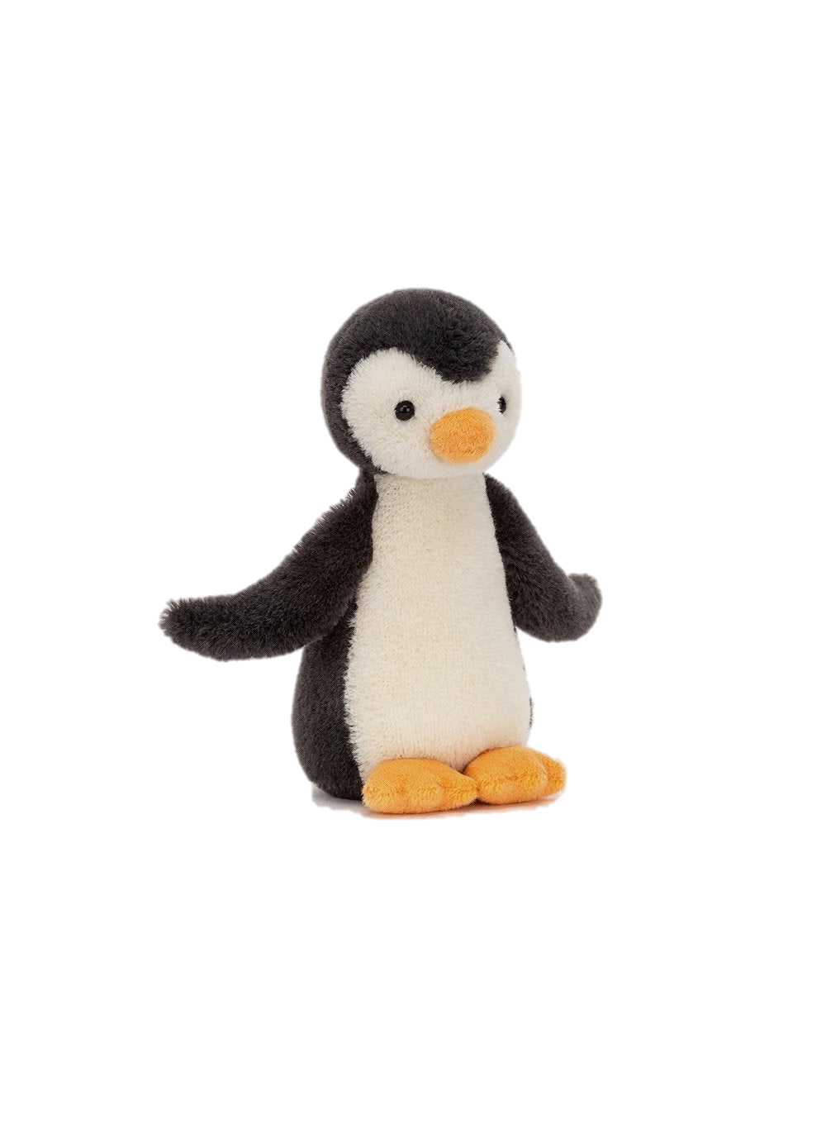
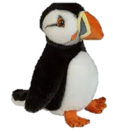
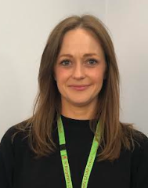
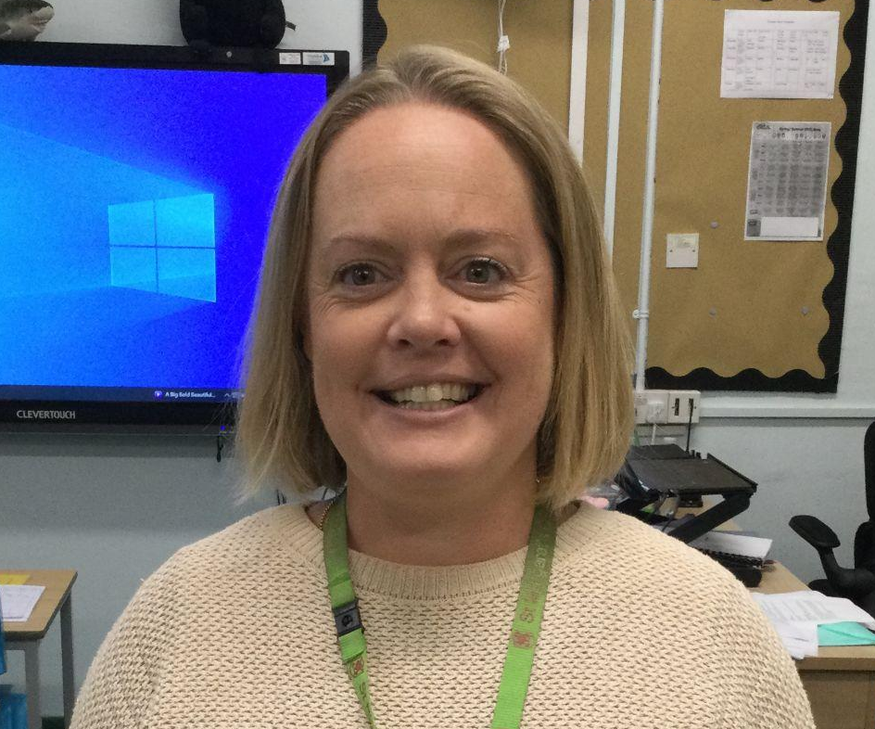
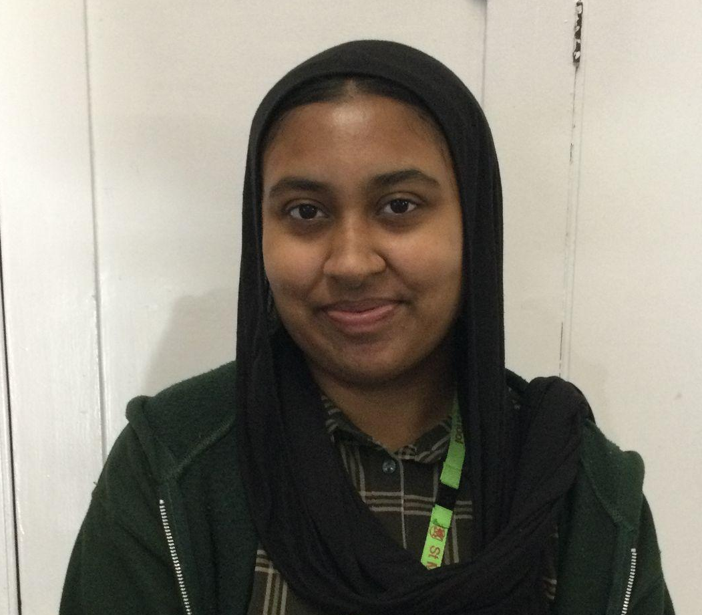
The adults that work in Reception
Mrs Rodger
Puffins Class Teacher
Weds PM-Fri
Mr Luetchford
Penguins Class
Teacher
Mrs Maudsley
Early Years Leader
Mrs Lillistone
Teaching Assistant
Miss Choudhury
Teaching Assistant
Miss Rollund
Teaching Assistant
Mrs Gray
HLTA Penguins Mon PM
If you have a worry or concern, you should firstly approach the class teacher via email.
If you need to escalate your query for any reason, please talk to our EYFS Lead, Mrs Maudsley.

Slide 3
Contact details
If you need to contact your child’s teacher please can you email on
puffins@stmargaretsipswich.org
penguins@stmargaretsipswich.org
Emails will be checked regularly between the hours of 8 a.m. and 5 p.m. Monday to Friday.
We will be happy to answer any questions via email or we will phone
you if it is necessary.
You may not always get an immediate response so if it is something urgent or a change of who is picking your child up that day, please phone the school on 01473 251613

Slide 4
Drop off/Pick up
Mornings – you can drop your child off at school from
8.30 a.m. to 8.40 a.m
The school day ends at
3.10 p.m
Pick up – We take safeguarding very seriously at St Margaret’s and therefore need any picking up arrangements to be emailed to us on puffins@stmargaretsipswich.org, or penguins@stmargaretsipswich.org Any last minute changes, please phone the office.
  We assume your child will be collected by a parent unless told otherwise.
  If you have a regular arrangement, for example your child goes with a childminder every Tuesday, you must email us with this information stating the date and who this will be.
  We need advance notice of any changes to the arrangements for picking up via email.
If you need to speak to your child’s teacher, please email to arrange a phone call.

Slide 5
General messages
Children may bring a water bottle into school – water only,
NO squash/juice/milk.
In the morning, please encourage your child to hold their book bag in one hand and their water bottle in the other. This will help to prevent spillages and gets them into the routine of popping their water bottles into the tray each morning (therefore we can monitor their water intake).
Morning fruit snack is provided by the school. If your child wishes to bring their own snack from home, it MUST ONLY BE FRUIT and in a named pot.
Medication – Only prescribed medicine can be delivered at school, please go to the school office where you will be able to fill in a form. If your child needs calpol during the day, you will need to come to school to give it to them.
Dress your child appropriately for the weather. We learn outdoors in all weathers so please send a coat in every day. If you would like your child to have a change of shoes, please send them into school with welly boots.

Slide 6
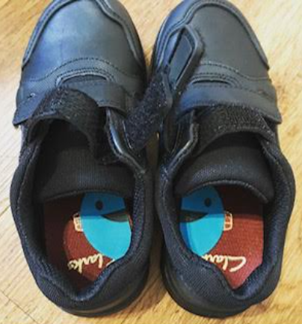
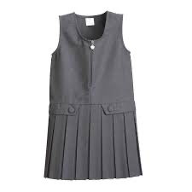
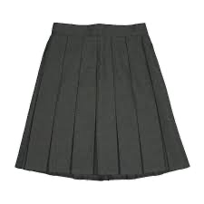


Uniform
Please ensure ALL uniform is named.
Shoes – either named or pop a sticker in them so the children can easily recognise them.
Spare uniform to be kept in drawstring bag on child’s peg please.
As per uniform guidelines, only stud earrings to be worn and long hair must be tied back.
Winter Uniform
Summer Dress

Slide 7
P.E.
Children take part in a weekly P.E. lesson. For now, we will be exploring how to negotiate spaces successfully and moving in different ways.
We are starting our PE sessions this Friday. Children should come to school in their PE kit every Friday.
No PE bags please.

Slide 8
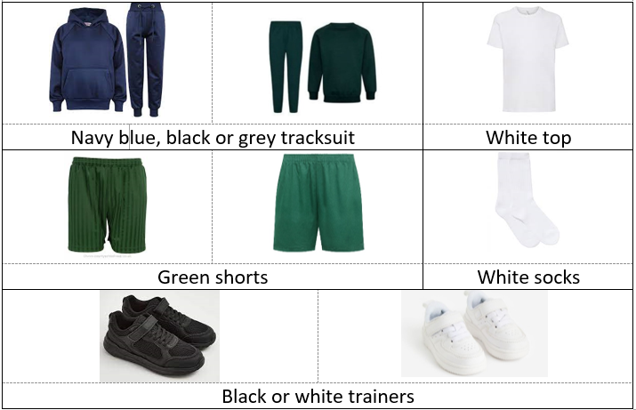
PE uniform

Slide 9
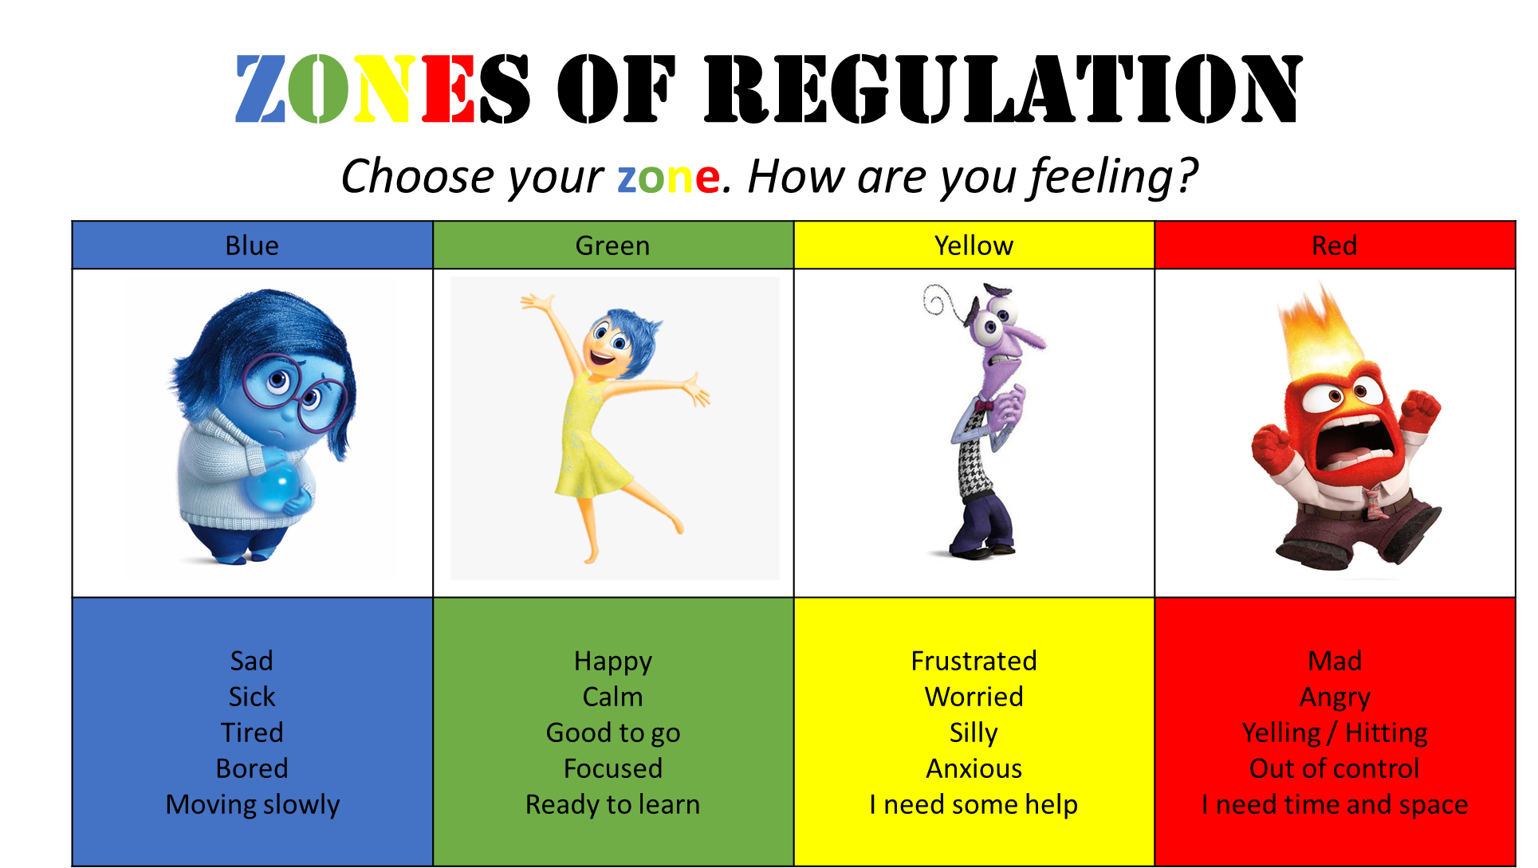
The four Zones of Regulation

Slide 10





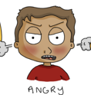



The Yellow Zone is also used to describe a heightened state of alertness and elevated emotions, however one has more control when they are in the Yellow Zone. A person may be experiencing stress, frustration, anxiety, excitement, silliness, the wiggles, or nervousness when in the Yellow Zone.
The Blue Zone is used to describe low states of alertness and down feelings such as when one feels sad, tired, sick, or bored.
The Green Zone is used to describe a calm state of alertness. A person may be described as happy, focused, content, or ready to learn when in the Green Zone. This is the zone where optimal learning occurs.
The Red Zone is used to describe extremely heightened states of alertness and intense emotions. A person may be elated or experiencing anger, rage, devastation, or terror when in the Red Zone.

Slide 11
Learning Ladders
Learning Ladders is an online learning journal which we use to show you your child’s progress at school.
All parents will all receive an invitation to register for Learning Ladders.
We will update ‘wow moments’
Group observations – please do not share on social media
When Learning Ladders is up and running, if you would like to, please upload pictures/videos to show teachers your child’s interests or achievements outside of school.

Slide 12
Phonics
Children will take part in daily phonics lessons as soon as we feel they are ready.
Initially your child will have a reading book with no words or words that you need to read with/to them. Once your child has a good knowledge of initial sounds and is beginning to blend simple words, a phonetically plausible book will be sent home as well as a “read with me” book.
We will provide a reading diary to record which books your child reads during the year. Please write comments when you have heard your child read.
Reading books will be changed weekly. It is very important that you send your child with their reading book everyday.
Phonics workshop – We will be holding a phonics workshop this term.

Slide 13
Reports and Parents Evenings
Your child will receive a termly report.
There are Parents evenings in both the Autumn and Spring Terms. Timings will be confirmed at a later date.
Early Years Newsletter.

Slide 14









Please remember…

