Slide 1

Welcome to
St. Margaret’s School
New Parents’ Meeting
2025 – 2026

Slide 2
Introductions
Headteacher – Revd J Gunn
Deputy Headteacher - Mrs S Cashen
AHT/Early Years Lead + Puffins Teacher - Mrs F Maudsley
Penguins Class Teacher –
Mr J Luetchford

Slide 3
Penguins
Puffins
Class Teacher:
Mr J Luetchford
Teaching Assistants
Class Teacher:
Mrs F Maudsley
(3.5 days)
Teaching Assistants

Slide 4

Early Years Curriculum
Acquiring new knowledge and demonstrating their understanding through 7 areas of learning.
All are vital and inter-connected.
      Personal, Social and Emotional Development
      Communication and Language
      Physical Development
      Literacy
      Maths
      Understanding the World
      Expressive Arts and Design

Slide 5

Personal, Social and Emotional Development
This area includes Self-Regulation, Managing Self and Building Relationships

Slide 6
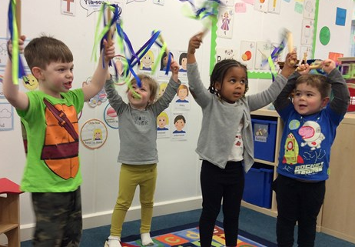
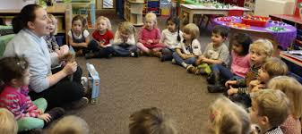
Communication and Language
This area includes Listening, Attention and Understanding, and Speaking.

Slide 7
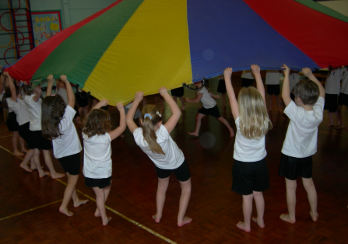
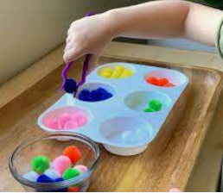
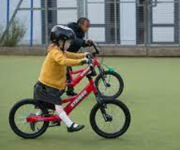
Physical Development
This area includes Gross Motor Skills and Fine Motor Skills.

Slide 8
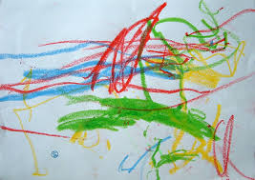
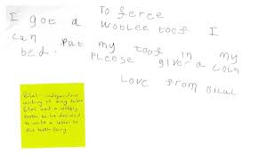

Literacy
This area includes Comprehension, Word Reading and Writing

Slide 9

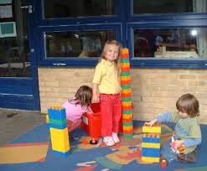
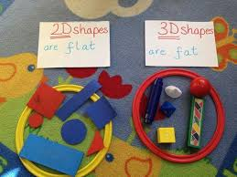
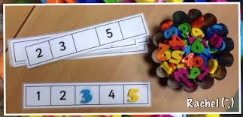

Maths
This area includes Number and Numerical Patterns.

Slide 10

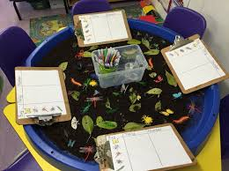
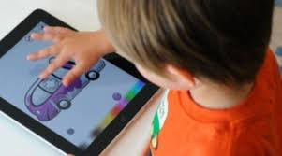
Understanding of the World
This area includes Past and present, People, Culture and Communities, and The Natural World.

Slide 11

Expressive Arts and Design
This area includes Creating with Materials, and Being Imaginative and Expressive

Slide 12
Preparing your child
Can listen to a short story | Follow a series of simple instructions
Use the toilet independently | Develop fine motor skills
Put jumper and coats on | Lunchtimes- can feed themselves
Share and take turns | Can recognise own name
Notes:
Mr L

Slide 13



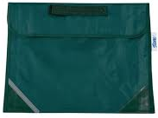
Uniform
ALL uniform MUST be named
School sweatshirt with logo
Green logo coats
School book carriers
Available from C & D uniform Solutions only
ORDER BY 7TH JULY for school collection
Other shops
Grey skirt/trousers/shorts
Green Striped dress only
Black shoes
Grey/white socks
2nd hand uniform - tonight
Notes:
Mr L

Slide 14
Equipment
On PE days, please can your child come in their PE Kit:
Green shorts/black jogging bottoms
White t – shirt
Black plimsolls or trainers-velcro
White P.E. socks
PLEASE NAME ALL P.E KIT
Please also provide a paint shirt and wellie boots to keep in school.
Notes:
Mr L

Slide 15
Wrap around care
Breakfast Club – Everyday 8.00 a.m. to the start of school.
After School Club – until 5.30 p.m. (end of session )
Miss Margaret Woodhams (childminder) 01473 405856

Slide 16
Communication
Newsletters are sent home regularly via Parentmail
If your child is poorly, please phone in the morning before school starts
If you need to talk to a teacher, please make an appointment with the School Office.
Let us know any change in arrangements after school

Slide 17
The Inclusion Team
Inclusion manager – Mrs Richards
Wellbeing Team –
Forest School
Drawing and Talking therapy
Emotional wellbeing
Multi-lingual support
Senco – Mrs Sheeran
Supports pupils with additional learning needs

Slide 18
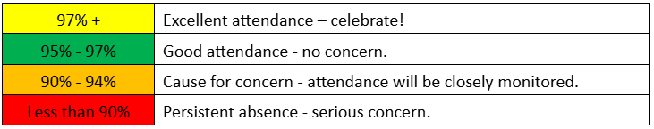
Attendance
Why is attendance so important in Early Years?
Start as you mean to go on!

Slide 19

Dates for your diary
Parent/teacher transition meetings Thursday 12th June or Monday 16th June – Please book an appointment, sign up sheets are on the table. Please bring passport/birth certificate for the office to take a photocopy.
We will tell you which class your child will be in by Friday 20th June.

Slide 20
Dates for your diary
Induction Morning–
Thursday 26th June 9.30 a.m – 11.00 a.m.
Story time sessions: Friday 4th July or Tuesday 8th July 2.30 p.m. - 3.00 p.m. (Please sign up)
September dates and times will be shared with you before the summer holidays.
Meet the Teacher open evening – dates to be confirmed for September

Slide 21
September induction process
WEDNESDAY 3rd – WEDNESDAY 10TH SEPT
We be offering 6 morning and 6 afternoon sessions (Wed – Wed)
THURSDAY 11th and FRIDAY 12th will be all day sessions including lunchtime
This will help with the children learning key routines as a small group before experiencing this as a whole class
We will email you all upcoming dates

Slide 22
Your next steps
Complete all necessary paperwork
Sign up for 1:1 Transition Meeting and story session
PTA – Mrs Eleanor Hart
Uniform
Any questions?
Please visit the Puffins and Penguins Classes

