Slide 1
Zones of Regulation

Slide 2
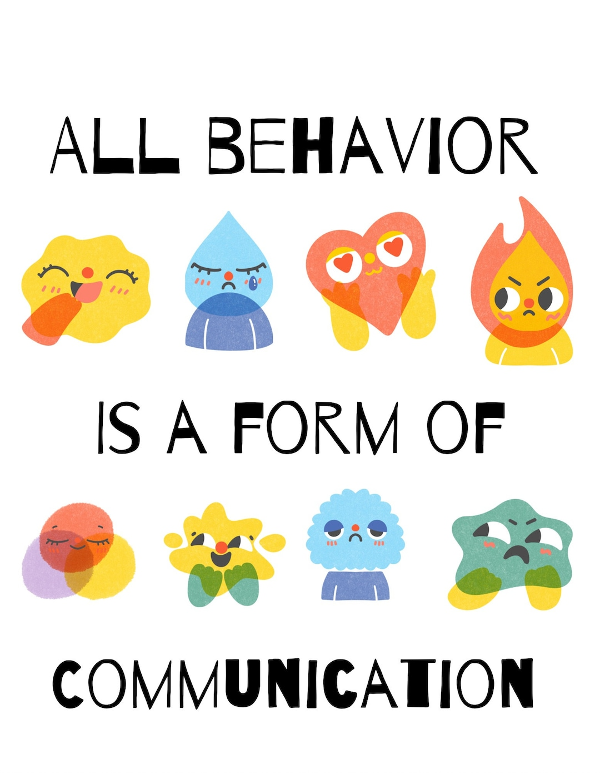
What is ‘Zones of Regulation’?
A framework to simplify how we think about and manage our feelings and emotional states
Complex feelings and states are categorised into four coloured ‘Zones’
Through supporting the pupils, they will develop ‘tools’ that can help move between Zones
A framework that improves the ability to recognise and communicate feelings in a safe, non-judgemental way
What it is not:
A discipline or behaviour model/chart
Punitive or shaming of negative behaviours

Slide 3
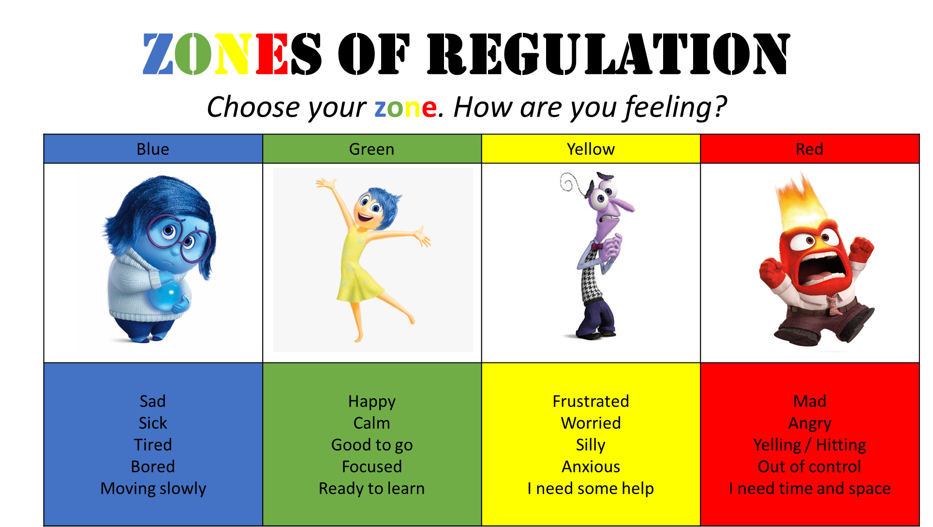
The four Zones of Regulation

Slide 4



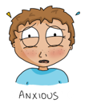


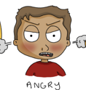
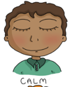
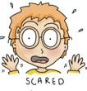
The Yellow Zone is also used to describe a heightened state of alertness and elevated emotions, however one has more control when they are in the Yellow Zone. A person may be experiencing stress, frustration, anxiety, excitement, silliness, the wiggles, or nervousness when in the Yellow Zone.
The Blue Zone is used to describe low states of alertness and down feelings such as when one feels sad, tired, sick, or bored.
The Red Zone is used to describe extremely heightened states of alertness and intense emotions. A person may be elated or experiencing anger, rage, devastation, or terror when in the Red Zone.
The Green Zone is used to describe a calm state of alertness. A person may be described as happy, focused, content, or ready to learn when in the Green Zone. This is the zone where optimal learning occurs.

Slide 5
How are we going to support our pupils…
Set of lessons/Whole school assembly/parent presentation
Foster Emotional Awareness – begin to help the children recognise their emotional states. Eg, I’m feeling really excited now, I’m in the yellow zone. Modelling feelings helps the pupils understand this is for everyone!
Zones Display – 4 colours with names. We DO NOT move names – this is only to be done by the children
Zones friendly environment – ‘Regulation Station’, calm areas, visual cues/display
Support Self-Regulation Strategies – deep breathing, mindfulness, regulation activities, taking a break, sensory toys
All feelings are ok, even when on red!
Individual pupils – some pupils may need individual support and Z of R can be tailored to support their developmental stage

Slide 6
Reliable Repeated Routines - (The 3 Rs of learning behaviours)
‘Wonderful Walking’ – silent and to the left of the corridor
‘Lovely Lines’ – alphabetical order, keeping hands and feet to yourself
1,2,3 transitions
EY/KS1 - 1. Stand up from the carpet 2. Stand behind your chair 3. Sit down
KS 2 - 1. Stand up 2. Tuck your chair in 3. Line up in register order
‘Marvelous Manners’ – hold doors open. Stand to the side, please and thank you’s!

Slide 7
Unexpected behaviours
Recommended CLASSROOM regulation steps:
1. Emotion coaching (e.g. direct a pupil to the Zones of Regulation on the wall, encourage them to identify and share their feelings, facilitate “I feel … because …” conversations)
2. Reminder of rules & responsibilities
3. Regulation station in the classroom (a calm place designed for introspection)
4. Regulation station in another classroom / phase leader (as above)
5. Regulation with a member of SLT/Wellbeing Team (emotion coaching and support to reflect on the situation, using Restorative Practice)
Note: Stages can be escalated/skipped if someone is in danger

Slide 8
Regulation reports/informing parents
Regulation Reports:
If pupils are unable to regulate their emotions within their own classrooms and reach stage 4 above, a verbal regulation report will be given to the parent by the class teacher. This will include details of which zone their child was in, what the presenting behaviours were and how their child was supported to regulate before reaching stage 4.
If pupils' emotional dysregulation continues to stage 5 or above, a written Regulation Report will be completed by the member of the SLT or Wellbeing Team who supported the pupil and given to the parent (by the teacher) at the end of the school day.

Slide 9
Consequences for unexpected behaviour
Natural consequences and examples
Restorative Practice/actions -
What happened?
What were you thinking and feeling at the time?
What have you thought about it since?
Who has been affected and in what way?
How could things have been done differently?
What do you think needs to happen to make things right?

Slide 10
Responding to positive behaviours
Positive behaviour may be rewarded using methods such as:
Verbal and written praise
Team points
Letters home or phone calls to parents
Certificates, Dojo and stickers

Slide 11
Zones at Home
Before using Zones of Regulation at home:
Know yourself and how you react in difficult situations before dealing with your child’s behaviours.
Identify your child’s triggers.
Have clear boundaries/routines and always follow through.
Talk through the zones with your child and discuss:
What emotion they might feel in each zone e.g. in the yellow zone I may feel worried
How they physically feel in each zone e.g. in yellow zone I may have butterflies in my stomach or have sweaty palms (if feeling anxious).
What they might be doing in a particular zone e.g. in yellow zone would they might be pacing around, snapping at others, fidgeting?
Create a list of strategies and tools with your child that help them feel calm or more alert

Slide 12
How to support your child to regulate their emotions:
Help your child understand that it is ok to feel angry, be worried or scared but they do need to find ways to help themselves manage those uncomfortable feelings.
Do not deal with an angry or upset child when you are not yet calm yourself.
Support your child to regulate their feelings before you respond to their behaviour and discuss strategies for next time.
For example, if your child is angry and has hurt their sibling:
Empathise with them and validate what they are feeling.
Help them calm down using a strategy.
When they are out of the red zone, talking to them about their behaviour, give consequences if appropriate, and then identify what they should do next time they feel angry.

Slide 13
Calming and Alerting Strategies
Here are some ideas of tools you could put in your child’s box:
· Picture cards of sensory break activities e.g. stretching, star jumps (see example from twinkl).
· Self-Soothing Objects that help to calm you through your senses:
· Something to touch – e.g. stuffed animal, stress ball
· Something to hear – e.g. instrument, musical box
· Something to see – e.g. photographs of special memories, snowglobe, sensory bottle (see example from twinkl)
· Something to smell – e.g. candles, perfume, lavender bag
· Distractions to take your mind off the problem for a while, e.g. puzzles, colouring pages, books, artwork, crafts, sewing, wordsearches, Sudoku.:
· affirmations and inspiration – e.g. looking at drawings or motivational statements
· something funny – e.g. funny movies, books
· Mindfulness – tools for helping keep yourself in the present moment, e.g. grounding objects (rock, paperweight), breathing exercise cards (see example from twinkl).

Slide 14
Any questions?

