Slide 1
Welcome to Year 1
1A – Miss Allard
1H – Mrs Hall
with Miss Dozzell, Miss Miller-Clarke and Miss Whincop

Slide 2
Curriculum
Our topic question this term is ‘Who am I in my world?’
We will be reading the story ‘The Jolly Postman’ to inspire our writing; focusing on writing simple sentences that are decodable using phonic knowledge with finger gaps between words, capital letters and full stops. We will introduce the use of ‘and’ to join sentences.
Maths will concentrate on place value, addition and subtraction within 10.

Slide 3
Curriculum
Phonics sessions happen every day. Children will be taught to recognise phonemes (sounds) and graphemes (letters) to enable them to decode (read) and segment (write) words. They will also learn to read and write tricky words that cannot be learnt through phonics.
In June, all pupils will complete the year 1 phonics screening check to assess their knowledge.

Slide 4
Curriculum
We will be exploring the geography of our local area and exploring the history of Bonfire Night. In English, we will be reading a book written by a British-Indian author with written tasks inspired by the text.
Art and DT will be inspired by geography, history and our English text to include portraits and bridge building
There is more detail on the Autumn Curriculum Plan, on our webpage.

Slide 5
Reading
Children will have a levelled reading book to read at home.
Each read at home should be signed by an adult in their Reading Record.
Pupils will be getting library books for reading for pleasure in a few weeks time.

Slide 6
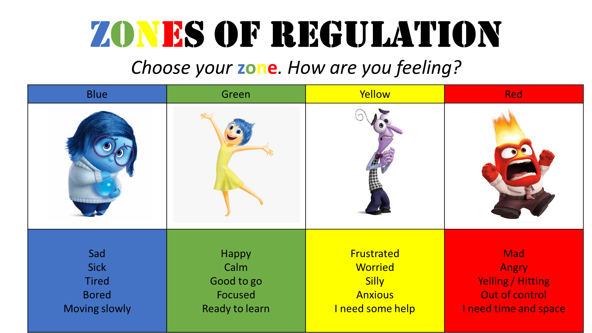
The four Zones of Regulation

Slide 7


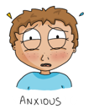



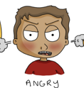


The Blue Zone is used to describe low states of alertness and down feelings such as when one feels sad, tired, sick, or bored.
The Yellow Zone is also used to describe a heightened state of alertness and elevated emotions, however one has more control when they are in the Yellow Zone. A person may be experiencing stress, frustration, anxiety, excitement, silliness, the wiggles, or nervousness when in the Yellow Zone.
The Red Zone is used to describe extremely heightened states of alertness and intense emotions. A person may be elated or experiencing anger, rage, devastation, or terror when in the Red Zone.
The Green Zone is used to describe a calm state of alertness. A person may be described as happy, focused, content, or ready to learn when in the Green Zone. This is the zone where optimal learning occurs.

Slide 8
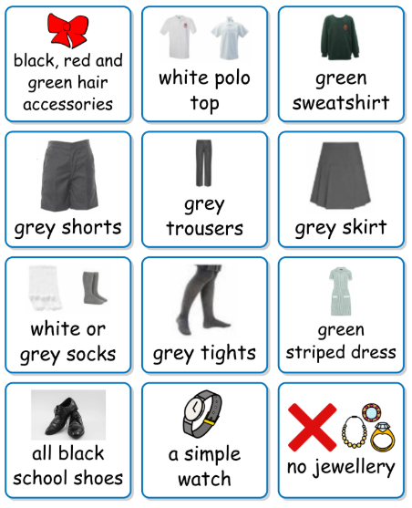
Uniform
School Uniform
Grey bottoms (skirt, shorts or trousers)
White polo shirt
School jumper
Grey socks
Black shoes (not boots or trainers)
Green and white striped dress in the summer
Black, green or red hairbands

Slide 9
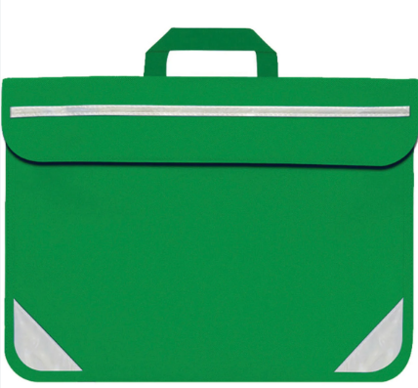
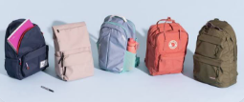
Bags
Book bags
NO book bags – we don’t have room on the pegs for them

Slide 10
P.E.
Our PE days are Monday and Thursday.
Please send your children to school in their PE kit.
Jewellery must be removed.

Slide 11
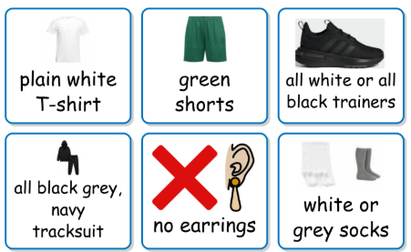
P.E. Uniform
PE uniform
Green shorts
White t-shirt
Navy blue or black tracksuit
Plimsoles or trainers
White socks
NO earrings

Slide 12
Any questions?
If you have any further questions please send them to:
year1@stmargaretsipswich.org
We will respond during office hours.

