Slide 1

SEN Information Report
2025 - 2026

Slide 2

SEN information Report 2025 -2026
Who can I contact?
Kinds of SEN
Approaches to teaching pupils with SEN
Matching the Curriculum to pupil’s needs
Inclusivity
Supporting emotional and social development
Family support worker
Assessing progress and support
In partnership with others
Transition
Involving parents
Effectiveness of Provision
Expressing any concerns
Suffolk Local Offer

Slide 3


Who can I contact for information?
Your child’s class teacher is the first point of contact for any initial concerns
in school. Following this, please contact:
The SENDCO, Mrs Sheeran.
Email: senco@stmargaretsipswich.org
Phone: 01473 251613
Alternatively, if you are seeking support for your child’s Emotional, Mental Health and Wellbeing you may wish to contact Mrs Richards, the school’s Inclusion Manager on inclusion@stmargaretsipswich.org
Suffolk SENDIASS
Suffolk SENDIASS (Special Educational Needs and Disabilities Information Advice and Support Service) is a confidential and impartial information, advice and support service on issues related to Special Educational Needs and Disability (SEND). It is free, easy to access and confidential.
They offer information, advice and support to:
Children and young people (up to 25 years) with SEND
Parents and carers of children with SEND
Return to Menu

Slide 4
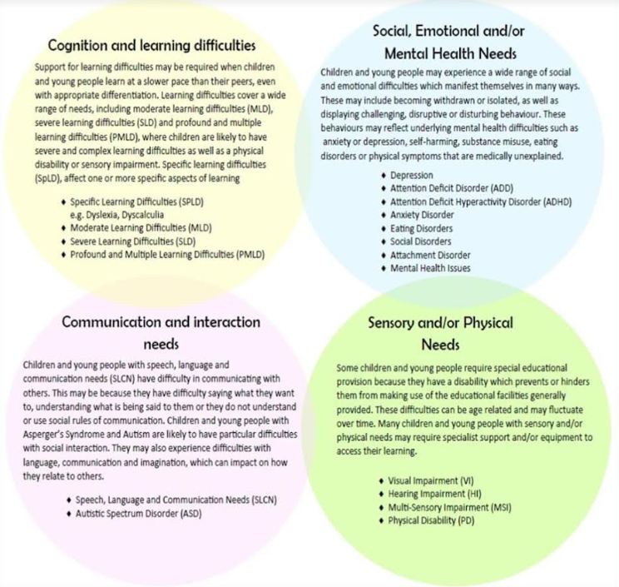
What kinds of SEN are there?
Return to Menu
Notes:
1.30

Slide 5
Definition of SEND?
In line with the SEND Code of Practice (2015):
A young person has special educational needs where their learning difficulty or disability calls for special educational provision, namely provision different from or additional to that normally available to pupils of the same age.
A young person has a learning difficulty or disability if they:
(a) Have a significantly greater difficulty in learning than the majority of others of the same age,
or (b) Have a disability which prevents or hinders them from making use of facilities of a kind generally provided for others of the same age in a mainstream school
Our school SEND Register
For a child to be placed on the school’s SEND register:
They must have a learning or physical difficulty that creates a ‘barrier to learning’.
They make significantly less progress than their peers - 18/24 months below age related expectations in core subjects.
They need provision which is different from or additional to that available through High Quality Teaching.
Return to Menu

Slide 6
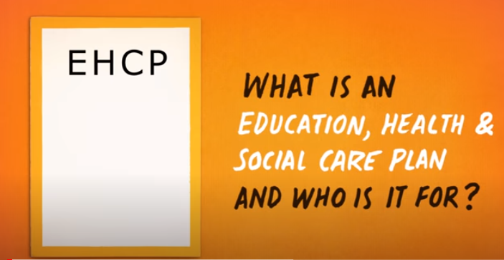
Types of SEND
A student with SEND will be recorded in one of two categories:
• SEND Support. These are students with an additional need. They need provision which is different from or additional to that available through High Quality Teaching.
• Educational Health Care Plan (EHCP) . An EHCP is for any child or young person that has a significant and complex Special Educational Need or Disability. An EHCP is required when a child’s needs cannot be met by the usual support that is available to them in their school or setting. An EHCP, sets out the education, healthcare and social care needs of a child or young person for whom extra support is needed in school, beyond that which the school can provide.
Please click the picture below for a video that explains EHCP’s further
Return to Menu

Slide 7

What is the approach to teaching pupils with SEND?
Teachers are responsible and accountable for the progress and development of all the pupils in their class.
At St Margaret’s, we aim to identify children with particular needs as early as possible.
High quality teaching, differentiated for individual pupils, is the first step in responding to pupils who have or may have SEN.
All teachers are teachers of children with SEND - a continuous cycle of assess, plan, do and review (APDR) is firmly embedded.
Our Christian values are the basis for our teaching and learning, and we provide a caring and supportive environment which prepares our pupils as confident learners.
High expectations and removing barriers to learning is key to our school.
Children with SEND are offered the same opportunities as all other children
Children with SEND will receive support that is additional to or different from the provision made for other children. All our teachers take account of a child’s SEN in planning and assessment;
All children will access a broad and balanced curriculum (National Curriculum). This may be differentiated and adapted for individual pupils.
We will also provide appropriate strategies and interventions to support progress where appropriate.
Not all children with disabilities necessarily have special educational needs. All our teachers take action however, to ensure that children with disabilities are able to participate as fully as possible in the National Curriculum and statutory assessment arrangements.
Partnerships with parents are key. As part of the APDR cycle parents are made aware of the planned support and the school will seek parental involvement to reinforce or contribute to progress at home.
Return to Menu

Slide 8

How will the curriculum be tailored to my child’s needs?
We aim to provide high quality teaching for all pupils which is delivered by the Class Teacher. We make the following adaptations to ensure all pupils’ needs are met:
Adapting and scaffolding our curriculum to ensure all pupils are able to access it, for example, by grouping, 1:1 work, teaching style, content of the lesson, etc.
Differentiating and adapting work
Adapting our resources and staffing
Using recommended aids and assisted technology, such as laptops, coloured overlays, visual timetables, larger font etc.
Differentiating our teaching, for example, giving longer processing times, pre-teaching of key vocabulary, reading instructions aloud, etc.
Group or individual interventions are provided as appropriate.
Accessible toilets, lifts and ramps
Appropriate equipment and additional resources
The school always acts upon advice received from external agencies where the curriculum and/or learning environment needs to be adapted.
On an individual basis, we will assess when we may require a high level of funding and seek financial support from the Local Authority High Need Funding.
Return to Menu

Slide 9




How are children with SEND enabled to engage in activities with their peers?
Inclusive ethos
Children work and play with their peers.
All pupils are encouraged to take part in sports day, school plays and special workshops
Special curriculum themed days, including pupil wellbeing days.
Extra-curricular activities, before and after school clubs and educational visits are available to all.
Depending on the specific needs of a child a more personalised access plan or individual health plan (IHP) will be drawn up in consultation with parents.
We have an ‘Accessibility Plan’ to ensure that pupils with SEN and Disability can take part in all aspects of school life.
The year 6 residential trip is open to all. Individual risk assessments will be completed where appropriate.
Return to Menu
Notes:
1.30

Slide 10



What support is available for improving emotional and social development of children with SEND?
We recognise that some children have extra emotional and social needs that need to be developed and nurtured. These needs can manifest themselves in a number of ways, including behavioural difficulties, anxiousness, and being uncommunicative. All classes follow a structured PSHE (Personal, Social, Health Education) curriculum to support this development. However, for those children who find aspects of this difficult we offer:
● Access to a Thrive practitioner/ELSA and/or Pastoral Support Worker for individual or group support
● Access to a Mental Health Lead/Inclusion Manager
● A Forest Schools programme
● Lunchtime Club
● Support from outside agencies e.g. play therapist, counselor, art/music therapist
● Alternative provision programmes e.g. Green Light Trust forest schools, PLOT
● Young Carers
● Intervention programmes e.g. Time to Talk (KS1), Socially Speaking (KS2)
● Drawing and Talking – emotional support for any children in school who have difficulties with expressing their feelings (delivered by Pastoral team)
● Use of school Chaplain
● Pupil Wellbeing Champions
● Pupil wellbeing days
● Check-in times with TAs/Pastoral staff to support transition and settling in.
● Referral to the School Nursing Service or Emotional Wellbeing Hub. Parents can also refer directly to these services themselves.
.
Return to Menu

Slide 11
What support can the Inclusion Manager give?
Our Inclusion Manager, Mrs Richards is experienced in supporting families with a wide range of issues and concerns related to home or school life.
Support can be offered in a number of ways:
- Provide information and support to children and families to get the help they feel they need.
- Promote and enhance the relationship between home and school.
- Work in partnership with a range of agencies and professionals to deliver support and interventions e.g. Early Help, financial support and signposting, Young Carers
- Support with parenting offering helpful routines and strategies to use in the home.
- Offer mental health, emotional and social support for children whilst in school.
- Support with attendance and punctuality
For more details please look at the Wellbeing and Family Support page on the school website.
Our Inclusion Manager can be contacted via the school office on 01473 251613.
Email – inclusion@stmargaretsipswich.org
Return to Menu
Notes:
1.30

Slide 12

What are the arrangements for assessing and reviewing the progress that each child with SEND is making?
We follow the ‘graduated response’ and the four-part cycle of Assess, Plan, Do, Review., more details on this can be found on slides 14 and 15. In addition:
● As part of High Quality Teaching teachers will use Assessment for Learning (AfL) strategies e.g. questioning as part of their day-to-day teaching to assess the learning of all pupils.
● We track the attainment and progress of each child in all National Curriculum subjects.
● The Headteacher and Assessment Lead hold regular Pupil Progress Meetings with all teachers.
● Children who are identified as having a Special Educational Need or Disability will have an One Page Profile (OPP) which will be reviewed with the parent and child every term and the plan for the next term made.
● Formal assessments are conducted inline with Government requirements
● When formally assessing children with SEN, consideration regarding ‘access arrangements is looked at on a case by case basis
● The SENDCo holds termly meetings with all teachers to discuss the progress and development of all pupil’s on the SEN register.
● Initial concerns about a child’s progress are discussed initially by the teacher with the parents. Following this a teacher may then make a referral to the SENDCo, sighting the strategies they have already tried (APDR).The SENDCo will then meet with the teacher, parent and child, and support will be put into place using the ‘graduated response’, APDR cycle.
Return to Menu

Slide 13
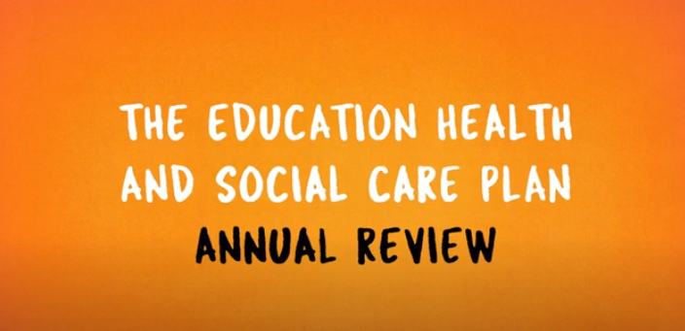
Continued…
What are the arrangements for assessing and reviewing the progress that each child with SEND is making?
● Specific assessments and reviews of these assessments will be carried out by the SENDCo or external agency e.g. SALT, SES, depending on the individual needs of the child.
● Evidence within the pupil’s books, provision timetables and the views of the child and their parents will provide additional information for assessment and review.
Children with EHCPs
● Small step/termly targets are in place for all children with an EHCP, these are created and reviewed with the child and the parent on a termly basis.
● The progress of children with an EHCP is formally reviewed each year, at an Annual Review, alongside the child and with all adults involved with the child’s education. Please click on the video below to find out more about the Annual Review process.
Return to Menu

Slide 14
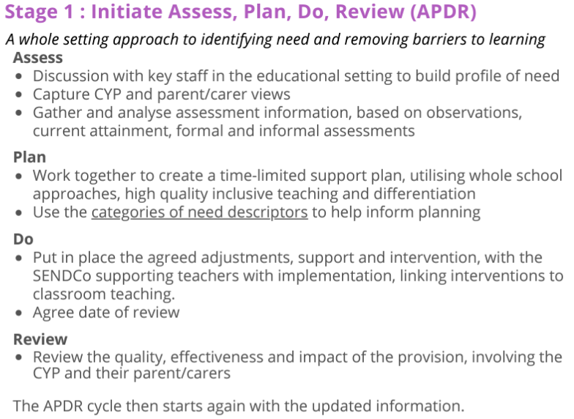
How does the ‘graduated approach’, Assess, Plan, Do, Review (APDR) work?
Where a pupil is identified as having SEN, the school will take action to identify need, and remove barriers to learning. This will take the form of a four-part cycle known as Assess, Plan, Do, Review (APDR). This is known as the graduated approach. It draws on more detailed approaches, more frequent review and more specialist expertise in successive cycles in order to match interventions to the SEN of the young person.
A One Page Profile (OPP) will be created.
Return to Menu

Slide 15
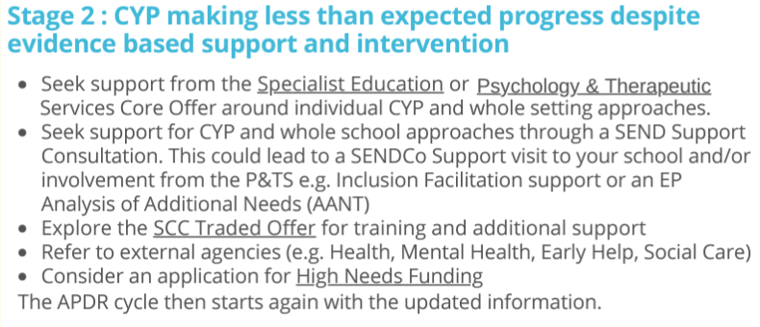
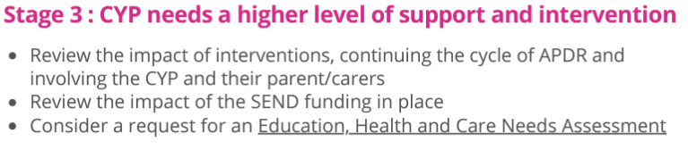
How does the ‘graduated approach’, Assess, Plan, Do, Review (APDR) work?
Return to Menu

Slide 16
What are the external agencies, specialist services
or professionals that are accessed by school?
The school works in partnership with the Local Authority, drawing on advice from the Family Service Teams, Specialist Education Services (SES), Psychology and Therapeutic Team, Educational Psychologists and other services such as Health, Social Care and family support services such as Bernardo’s, the Emotional Wellbeing Hub and SENDIASS.
Parents will always be involved in any decision to involve specialist support or other services.
School Provision | Local Authpority Provision | Health Provision | Support services and voluntary organisations
● Private speech and language therapist ● Thrive practitioner ● ELSA practitioner ● Pastoral support staff ● Inclusion Manager ● Higher Level Teaching Assistants Teaching Assistants working alongside teachers to provide differentiated and adapted curriculum activities. | ● Special Education Services (SES), Educational Psychology Service Sensory Service for children with visual or hearing needs ● Family Services (support children going through Statutory; EHC assessment) | ● School Nursing Team (parents can also make their own referral) - 0345 607 8866 ● Emotional Wellbeing Hub (parents can also make their own referral) - 0345 600 2090 ● Suffolk Neurodevelopmental; Pathway - Barnardo’s (NDD) ● NHS Speech and Language. ● Occupational Therapy Team | ● SENDIASS (01473 265210) ● IPSEA - Independent Provider of Special Educational Advice 0300 222 5899 ● Neurodevelopmental; Pathway - Barnardo’s (NDD)- NDDAdmin@barnardos.org.uk ● Autism/ADHD; training and support - info@autismandadhd.org
Return to Menu
Notes:
1.30

Slide 17

How will the school prepare and support my child to join the school or transfer to a new school
We recognise that transitions can be difficult for a child with SEND, and we take steps to ensure that any transition is as smooth as possible.
If your child is joining us from another school or setting:
● The SENDCo will visit preschools and Nurseries with the Early Years Leader when appropriate.
● They will receive a transition booklet, this will contain key information about the class, school and routines.
● Your child will be able to visit our school and stay for a taster session.
● Additional visits can be arranged where there is a need for this.
If your child is moving to another school:
● We will contact the school SENDCo and ensure they know about any special arrangements or support that need to be made for your child.
● Where possible, a planning meeting will take place with the SENDCo from the new school.
● We will make sure that all records about your child are passed on as soon as possible.
● We will authorise absences for visits to the school, which support the transition.
● We will work with the school to provide any additional information that would support the transition e.g. photo book, social story.
Return to Menu
Notes:
1.30

Slide 18

How will the school prepare and support my child
to join their next class and the next stage of education?
When moving classes in school at the end of an academic year:
● Information will be passed on to the new Class Teacher in advance
● A transition meeting will take place between the current and receiving teacher,
● One page profiles will be shared with the new teacher.
● A transition booklet will be created and available for all pupils with SEN and EHCPs.
● Any physical aids, such as writing slopes, privacy screens and ear defenders will be passed on to the new Class Teacher so they can continue to be accessed to support individual needs.
Moving to high school (in Year 6):
● The SENDCo will discuss the specific needs of your child with the SENDCo of the child’s high school.
● A transition meeting will take place with the teachers from the new school.
● Multi-agency meetings may be arranged to create a more detailed transition plan.
● Activities will be planned and delivered relating to aspects of transition.
● Where possible, your child will visit their new school on several occasions, and in some cases staff from the new school will visit your child in this school.
● If your child would be helped by visual resources to support them to understand moving on, then a social story and/or transition book will be made for them.
● Your involvement in this process will be crucial to support a successful move.
● Where a child has an EHCP, with parents permission the SENDCo at the school the parents have applied to will be invited to the Annual Review meeting, which in Year 6 will take place before October half term.
Return to Menu
Notes:
1.30

Slide 19

How do we consult and involve parents?
If you have concerns about your child, you should speak to your child’s class teacher first. Depending on the outcomes of these discussions you may have a follow up meeting with the SENDCo. We will have an early discussion with the pupil and parents when identifying whether they need special educational provision. These conversations will make sure that:
- Everyone develops a good understanding of the pupil’s areas of strength and difficulty
- We take into account the parents’ concerns.
- Everyone understands the agreed outcomes sought for the child
- Everyone is clear on what the next steps are
We will formally notify parents when it is decided that a pupil will be added to the SEN register. Parents of all pupils, including those with SEN are also invited to parent consultation evenings. Parents will be involved in meetings with outside agencies or outcomes of these meetings will be shared with parents.
When targets are set for pupils with SEN, using the graduated approach, APDR cycle parents are consulted and involved, on a termly basis in setting and reviewing their child’s targets, which are noted on their One Page Profile.
Pupils with EHCPs
For pupil’s with an EHCP, parents are involved and consulted in the creation and review of small step termly targets which build on the outcomes within the EHCP. For each child with an EHCP parents are also invited to share their views through the ‘Family view form’ as part of the Annual Review process. The Annual Review meeting must focus on progress towards the outcomes laid out in the EHCP, whether they remain appropriate and what changes might be needed. Parents will be consulted throughout the meeting.
Return to Menu

Slide 20

How will the school evaluate the effectiveness of
the provision for pupils with SEND?
We use a number of in-school measures to evaluate the effectiveness of provision for pupils with SEND. This includes:
● use of qualitative and quantitative data analysis to measure progress and achievement
● review of One Page Profiles 3x yearly
● use of assessment information/progress rates etc. pre- and post- interventions
● use of attainment and progress data for children with SEN across the school, which is part of whole school tracking of children’s progress in terms of National Curriculum levels of attainment
● The progress of children with an EHCP will be formally reviewed at an Annual Review with all adults involved with the child’s education.
● Regular book looks and lesson observations will be carried out by the Senior Management Team for all subjects across the curriculum to ensure that the needs of all children are met through appropriate differentiation, adaptations and inclusive practice.
● monitoring by SENDCo
Return to Menu
Notes:
1.30

Slide 21
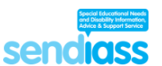
What if I am not happy with a decision or what is
happening for my child?
At St. Margaret’s, we take any complaints very seriously and will always strive to do our best to resolve them. This is best achieved through open and honest meetings involving all relevant parties and where necessary, independent support.
Where parents have concerns please speak to your child’s class teacher in the first instance.
The SENDIASS service can help, either by supporting parents at meetings or informing them of any further course of action that they can take.
They can be contacted via the telephone helpline on (01473) 256210 or enquires@suffolksendiass.co.uk or via following the link below:
https://www.suffolksendiass.co.uk/
Click the picture for a video explanation of what SENDIASS does:
Complaints procedure
The school has a complaints procedure which applies to complaints about SEND provision. Arrangements for handling complaints from parents of children with special educational needs (SEN) about the school’s support are within the Complaints procedure which can be found on the school website. Such complaints should first be made to the SENDCo, they will then be referred to the complaints policy.
Return to Menu

Slide 22

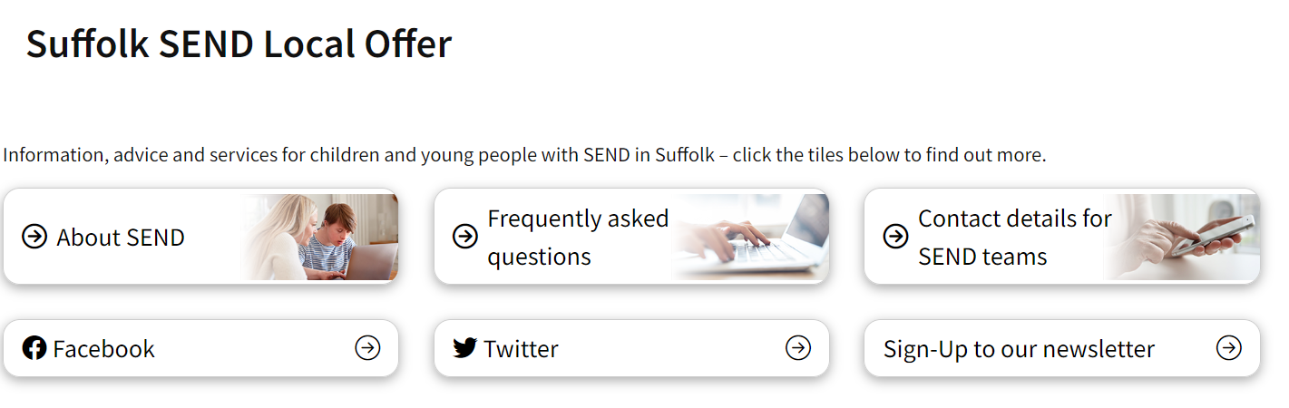

Click on the picture to access the Suffolk Local Offer
Return to Menu

