Slide 1
SATs
Information Evening
Wednesday 28th January 2026

Slide 2
What you will learn tonight
Brief History of SATs
SATs structure and scoring
SATs timetables for 2026
How to help your child

Slide 3
History of SATs
SATs Tests were introduced in 1991
By 1998, children were tested at ages 7, 11 and 14
Until 2016, the KS2 SATs papers graded pupils from Level 3 to Level 5
There was an additional paper (Level 6) to challenge the most able pupils

Slide 4

2016 Changes
In 2016, there were significant changes to the SATS tests.
All children now take the same papers. There is no separate Level 6 paper.

Slide 5


2026 SATs paper structure
English
Mathematics
Reading
Grammar
Spelling
Arithmetic
Reasoning 1
Reasoning 2

Slide 6
Mark Scheme
English
Mathematics
SPaG
45 minutes (50 marks)
Spelling test 15 minutes (20 marks)
Reading 1 hour (50 marks)
Arithmetic 30 minutes (40 marks)
Reasoning 40 minutes (35 marks)
Reasoning 40 minutes (35marks)

Slide 7
Mark Scheme
English
Mathematics
SPaG – Grammar and Spelling scores added together
Reading
All 3 Maths outcomes added together to give one overall score

Slide 8

2026 SATs scoring
The results are produced as:
A raw score
A scaled score
  80 is the lowest score
  120 is the highest score

Slide 9

Meaning of the scaled score
A score of 80 → 99 means the pupil has not met the expected standard
A score of 100→120 means that the pupil has met the expected standard

Slide 10
Example 2025 Conversion Table
English - Reading
Raw score Scaled score
25 98
26 99
27 99
28 100

Slide 11
2025 Conversion Table
English - SPaG
Raw score Scaled score
33 99
34 99
35 100
36 100

Slide 12
2025 Conversion Table
Maths – Arithmetic, Reasoning 1 and 2
Raw score Scaled score
58 100
59 100
60 100
61 100

Slide 13
Writing
Writing will be assessed in school by your child’s Class Teacher.

Slide 14
2026 SATs Timetable
Monday 11th May | Tuesday 12th May | Wednesday 13th May | Thursday 14th May
SPaG- 1. Grammar Paper | Reading | Maths - Paper 1: Arithmetic | Maths - Paper 3: Reasoning
2. Spelling Test |  | Maths Paper 2: Reasoning

Slide 15
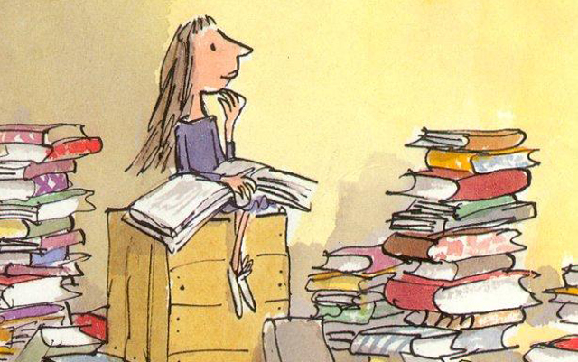
How to help your child
Encourage your child to read as much as possible
Make sure they relax and have other interests when they are not at school
Encourage your child to do their homework

Slide 16
Breakfast in SATs week!
Breakfast will be provided for all the children during SATs week

Slide 17
Reporting Arrangements
How SATS will be reported to parents

Slide 18

We are very proud of all the children and know that they have all done their best!

