Slide 1


5A
Mr Graham and Mrs Wray

Slide 2
STaffing
Class teacher- Mr Graham
Teaching assistant- Mrs Wray
Music teacher (Wednesday pm)- Mrs Gower
P.E coach (Wednesday pm)- Yash
HLTA (Ad hoc basis)- Mrs Hart/Mrs Gray/Mrs Joshua

Slide 3
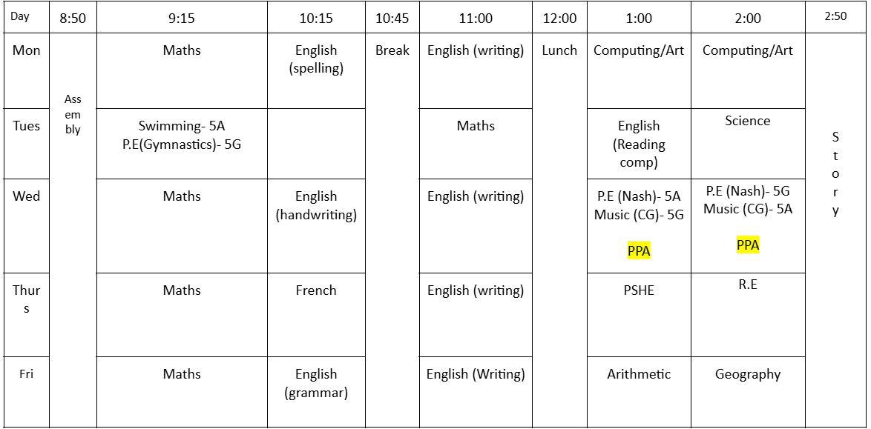
Timetable - Autumn 1

Slide 4
P.E Kit
Wednesday
https://www.stmargaretsipswich.org/school-uniform/
Please ensure you have the correct PE kit of green shorts and a white T-shirt. You can wear plimsolls or trainers. Later in the year, you can also wear a navy, grey or black tracksuit – we aim to enjoy PE, not freeze
Notes:
Lie - France

Slide 5
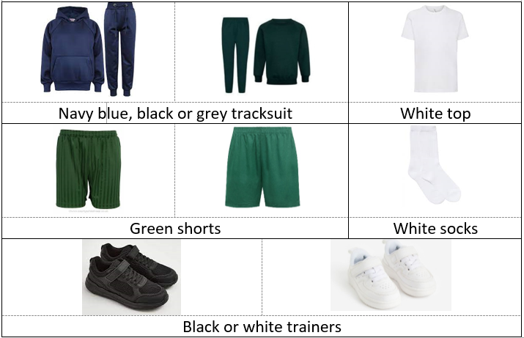

Slide 6
CLassroom
Water bottles
Trays
Pegs
Pencil cases
Fidget toys
Seating

Slide 7
Dietary
Children with dietary or allergy requirements will continue to be provided with a lanyard.
We ask children who have packed lunch to still wear these so staff in the hall are aware (monitoring food sharing etc)

Slide 8
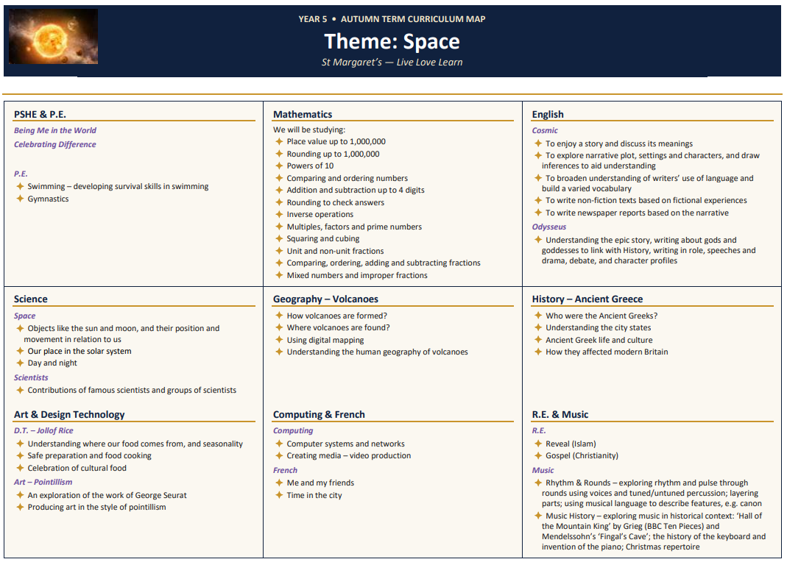
Curriculum

Slide 9
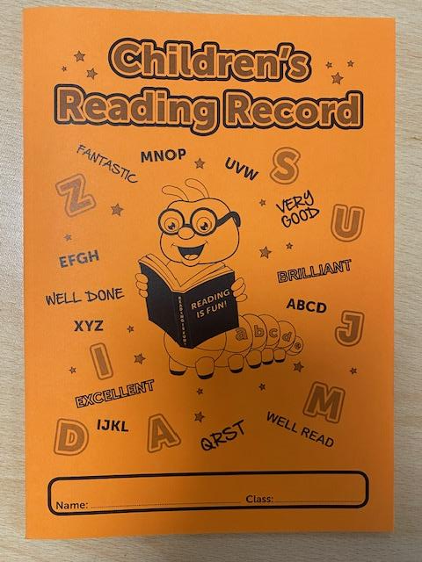
Homework
Will be due in Friday. English and maths
TT rockstars
Reading records checked Friday- 5 entries + signature
Please ensure your child has a record and reading
book each day
Notes:
Lie - France

Slide 10
Reading
The year 5 list is in the back of your child’s diary, please encourage them to engage with these as priority.
Class teachers have own book shelves also.
Our aim is for all children to have five entries per week (combination of in school and home reading).

Slide 11
Pen license
We aim for all children to have ‘earned’ a pen license ready for year 6
This will look different for all children
Promoting attention to presentation

Slide 12
Rewards
Team points for work in books, add to the tally charts and cross out
Dojos for great behaviour, kind friends, wonderful walking, answering questions in class
Christian value certificates
Whole school attendance incentives
Notes:
Lie - France

Slide 13
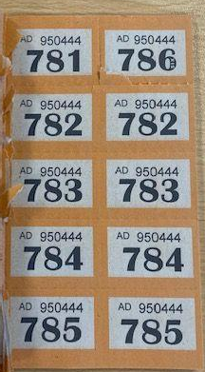
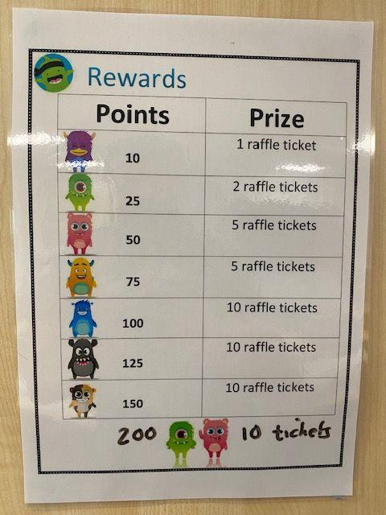
The raffle
Once a week we do a 5A class raffle.
You can earn raffle tickets by collecting Dojos and reading at home.
The raffle will be drawn every Friday.
I decide the number of tickets drawn.
Notes:
Lie - France

Slide 14
Questions
If you have any queries or concerns, the best way to contact us is through the class email.
year5@stmargaretsipswich.org
Notes:
Lie - France

