Slide 1

Phonics
guide for parents

Slide 2
What is phonics?
Phonics is a way of teaching children how to read quickly and skilfully.
Children are taught to read by breaking down words into separate sounds or ‘phonemes’. They are then taught how to blend these sounds together to read the whole word.

Slide 3
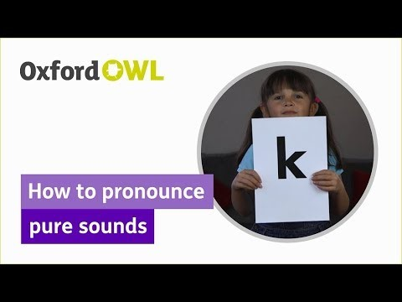
Although there are 26 letters in the English alphabet, there are more than 40 speech sounds.

Slide 4
Definitions
Phoneme – The smallest unit of sound in a word.
Grapheme – What we write to represent a sound/ phoneme – for some phonemes, this could be more than one letter. e.g. ai igh
Digraph- 2 letters making one size.
Trigraph- 3 letters making one sound.
Split digraph- 2 separated letters making one sound
CVC- consonant, vowel, consonant

Slide 5
Digraph
Two letters which make one sound.
A consonant digraph contains two consonants next to each other, but they make a single sound.
e.g. sh, ck, th, ll
A vowel digraph contains at least one vowel but the two letters still make a single sound
e.g. ai ee ar oy

Slide 6
Examples of consonant digraphs
ll ss ff zz
hill mess puff fizz
sh ch th
ship chat thin
ck ng qu
chick sing quick

Slide 7
Trigraph
Three letters, which make one sound.
sight fear chair

Slide 8
Split Digraph
Two letters, which are separated but make one sound (used to be called a magic E).
cake bone bike flute

Slide 9
Oral blending
Hearing a series of spoken sounds and merging (blending) them together to make a spoken word – no text is used.
For example, when children hear /b/u/s, they will say bus.
The skill is usually taught before blending using printed words.

Slide 10
Blending
Recognising the letter sounds in a written word, for example c- u- p, and blending them in the order which they are written, to read the word ‘cup’.
You can help by using pure sounds- not stretching the sounds e.g. t not t-uh.
Sound out and blend ‘alien’ words.

Slide 11
What do we use to teach Phonics in school?
We follow Twinkl Phonics scheme. This is a phased teaching programme which begins in Reception and continues through KS1.
We also provide activities in the classroom for children to rehearse and embed the skills they have learnt during the structured session.

Slide 12
Each Phonics session follows the same four part format
1. Revisit and Review
2. Teach
3. Practise
4. Apply

Slide 13
Level One
Level one comprises of seven aspects.
Aspect One: Environmental Sounds
Aspect Two: Instrumental Sounds
Aspect Three: Body Percussion
Aspect Four: Rhythm and Rhyme
Aspect Five: Alliteration
Aspect Six: Voice Sounds
Aspect Seven: Oral Blending and segmenting

Slide 14
Level Two
By the end of level two children should be able to read some vc and cvc words.
Children will also learn to read the tricky words
‘the, to, go, I and no.’

Slide 15
Level Three
Children are taught another 25 graphemes.
Children continue to blend and segment CVC words for reading and spelling.
Children will then use this knowledge to blend and segment two syllable words.

Slide 16
Level Four
By level 4 children are able to represent each of 42 phonemes by a grapheme. Children will be able to blend and segment CVC words for reading and spelling.
Level 4 is consolidation of children’s knowledge. Children are encouraged to practice blending for reading and segmenting for spelling of adjacent consonants.

Slide 17
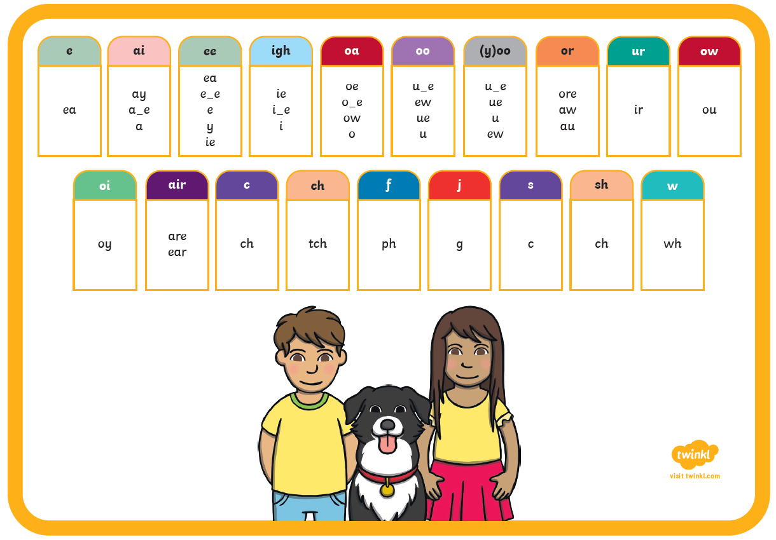
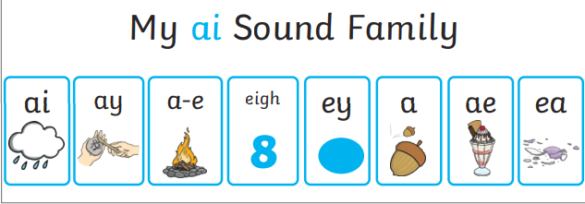
Level Five
Level 5 children teaches the children alternative ways of pronouncing and representing phonemes.

Slide 18
What is the Phonics Screening Check?
Every Year 1 child in the country will be taking the Phonics Screening Check during the same week in June.
The Phonics Screening Check is a quick and easy assessment of your child’s phonic knowledge.
The aim of the check is to ensure that all children are able to read fluently by the end of Year 2.
It helps the school to confirm whether each child has made the expected progress.
This ‘midpoint check’ will ensure that we have a clear understanding of what each child needs to learn in Year 2.

Slide 19
What will the children be expected to do?
Your child will be sat with their teacher and will be asked to read 40 words aloud. There will be 2 sections with 20 words in each section.
Your child may have read some of the words before, while others will be completely new.
Your child can use sound buttons to help them to read and blend the words
The check normally takes between 5 and 10 minutes to complete however there is no time limit. If your child is struggling, the teacher will stop the check. The check is carefully designed not to be in any way stressful for your child.

Slide 20
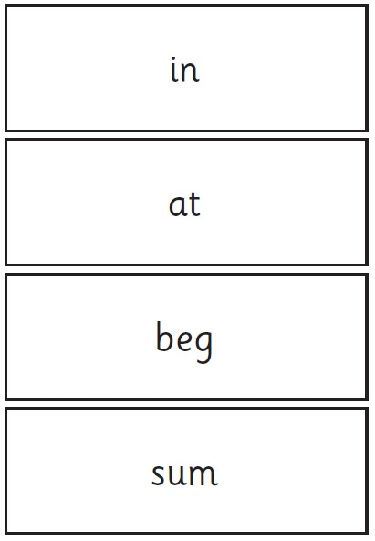

Examples of words

Slide 21
After the check
We will tell you about your child’s progress in phonics and how he or she has done in the screening check in the final half term of Year 1.
Children will be scored against a national standard (threshold yet to be determined by DfE) Though last year it was 32 correct words out of 40.
If your child’s score falls below the national standard they have to re-take the Phonics Screening Check in year 2.

Slide 22
What are we doing at school?
Daily phonics sessions – introducing, practising and applying new phonemes and alternative pronunciations
Guided reading including phonic based games, stories and activities
Shared reading of a variety of books and visual texts
Writing which helps the children to apply their phonic skills.

Slide 23
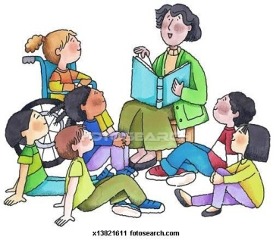
Helping your child with phonics
Phonics works best when children are given plenty of encouragement and learn to enjoy reading and writing.
Parents play a key role in helping with this.

Slide 24
Final thoughts….
Please remember that phonics is not the only skill needed to become a fluent reader.
Please continue to read with your child each night and encourage them to:
Sound words out from left to right
Re-read words to check they make sense
Use pictures for clues;
Ask questions about books
And most importantly…. ENJOY READING!

Slide 25
Useful Apps
Hairy Letters
Abc pocket phonics/lite
Mr Thorne does phonics
Phonics Play
Meet the alphablocks
Initial Code
Teach your monster to read

