Slide 1



Slide 2
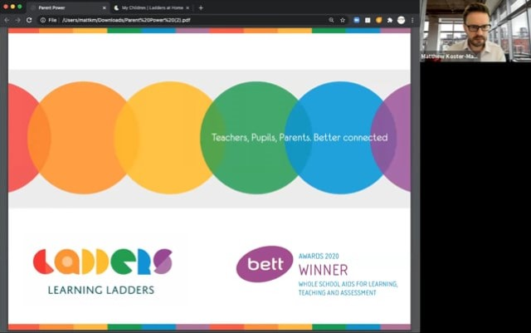

The rationale and reasons behind choosing Learning Ladders
- Mrs Brown Assessment Lead

Slide 3

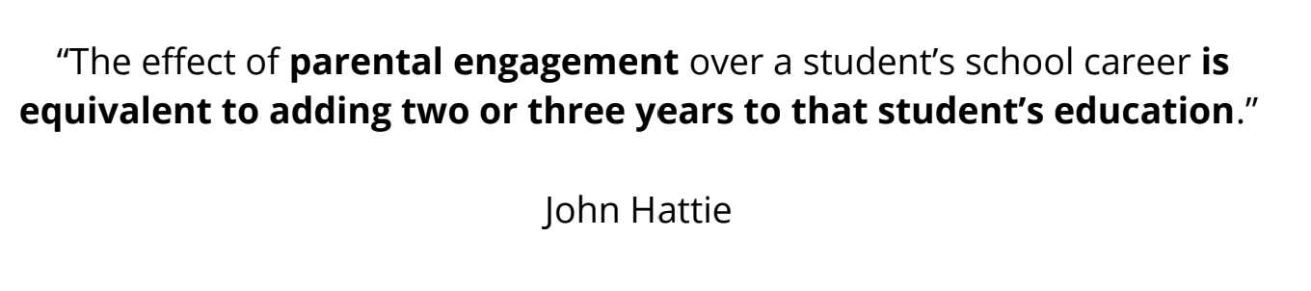
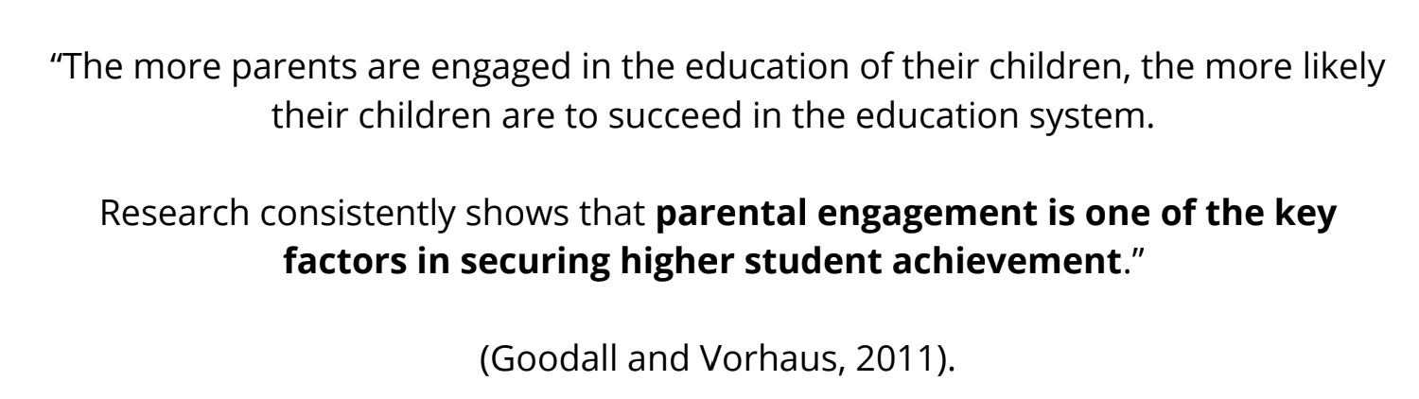
What does the research tell us?

Slide 4
All adults working in partnership to know exactly where a child is in their learning and how to support learning in school and at home.
Two-way messaging
Shared, personalised learning goals
Updates on the learning in the classroom
Bespoke individual student reports
Educational terms unlocked with support articles for parents

Slide 5
How do we access Ladders at Home?
One login for multiple siblings across school
Phase appropriate information shared for each stage of learning
Accessed via a URL on any device
Separate accounts for any adults involved in learning at home

Slide 6
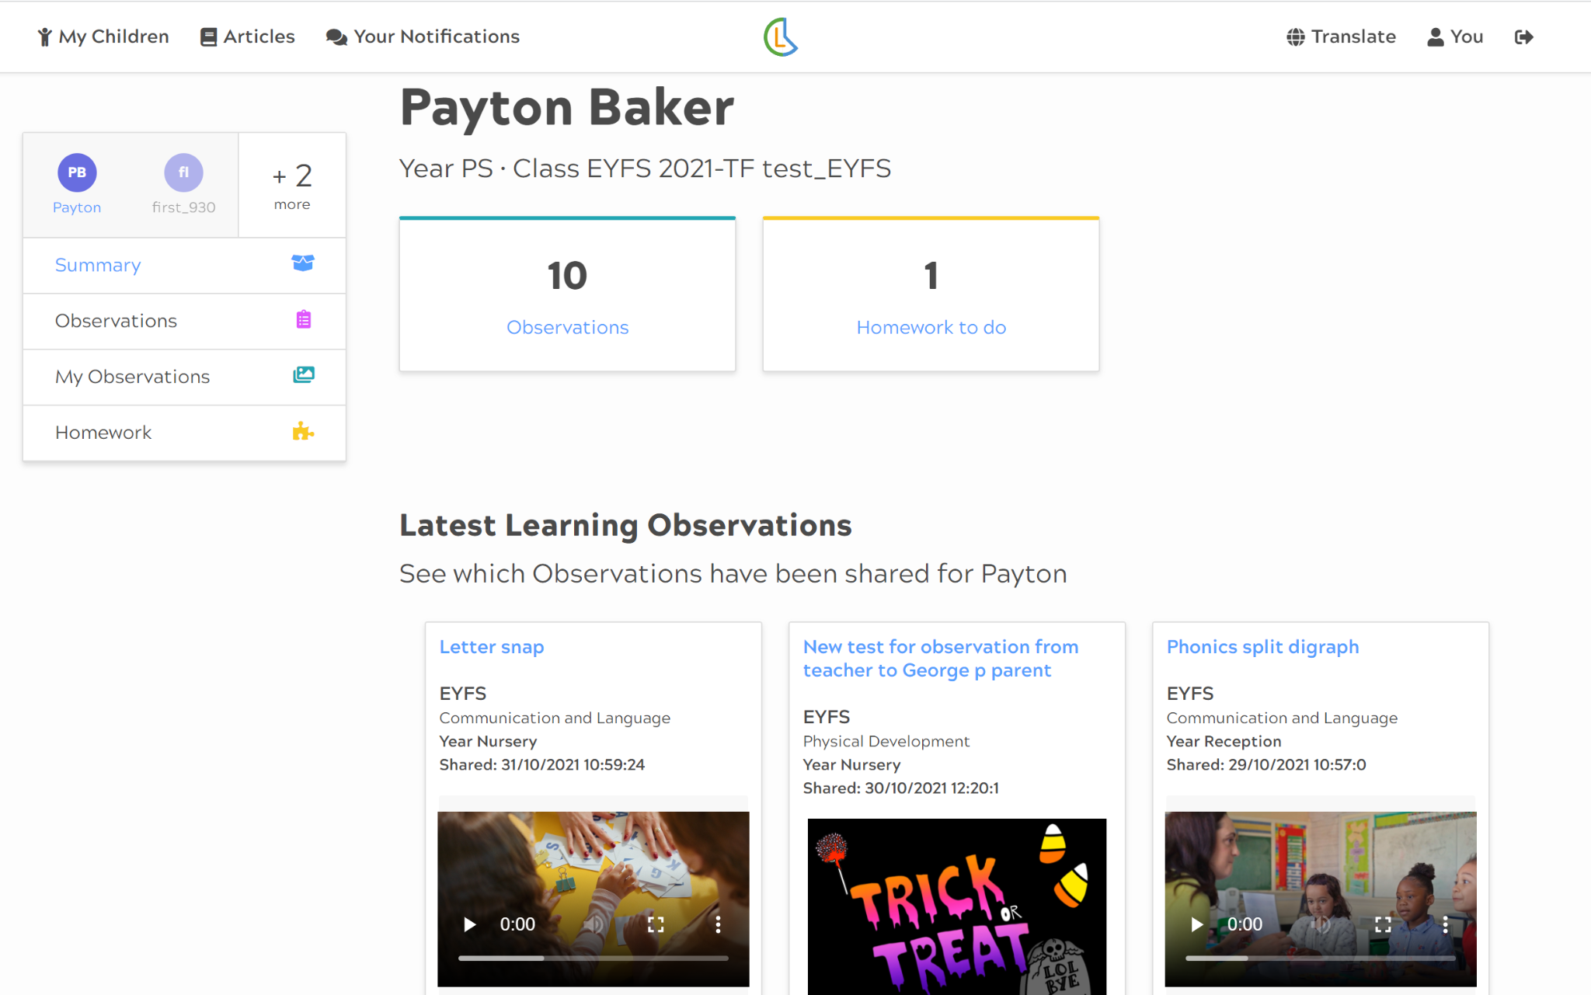
EYFS View

Slide 7
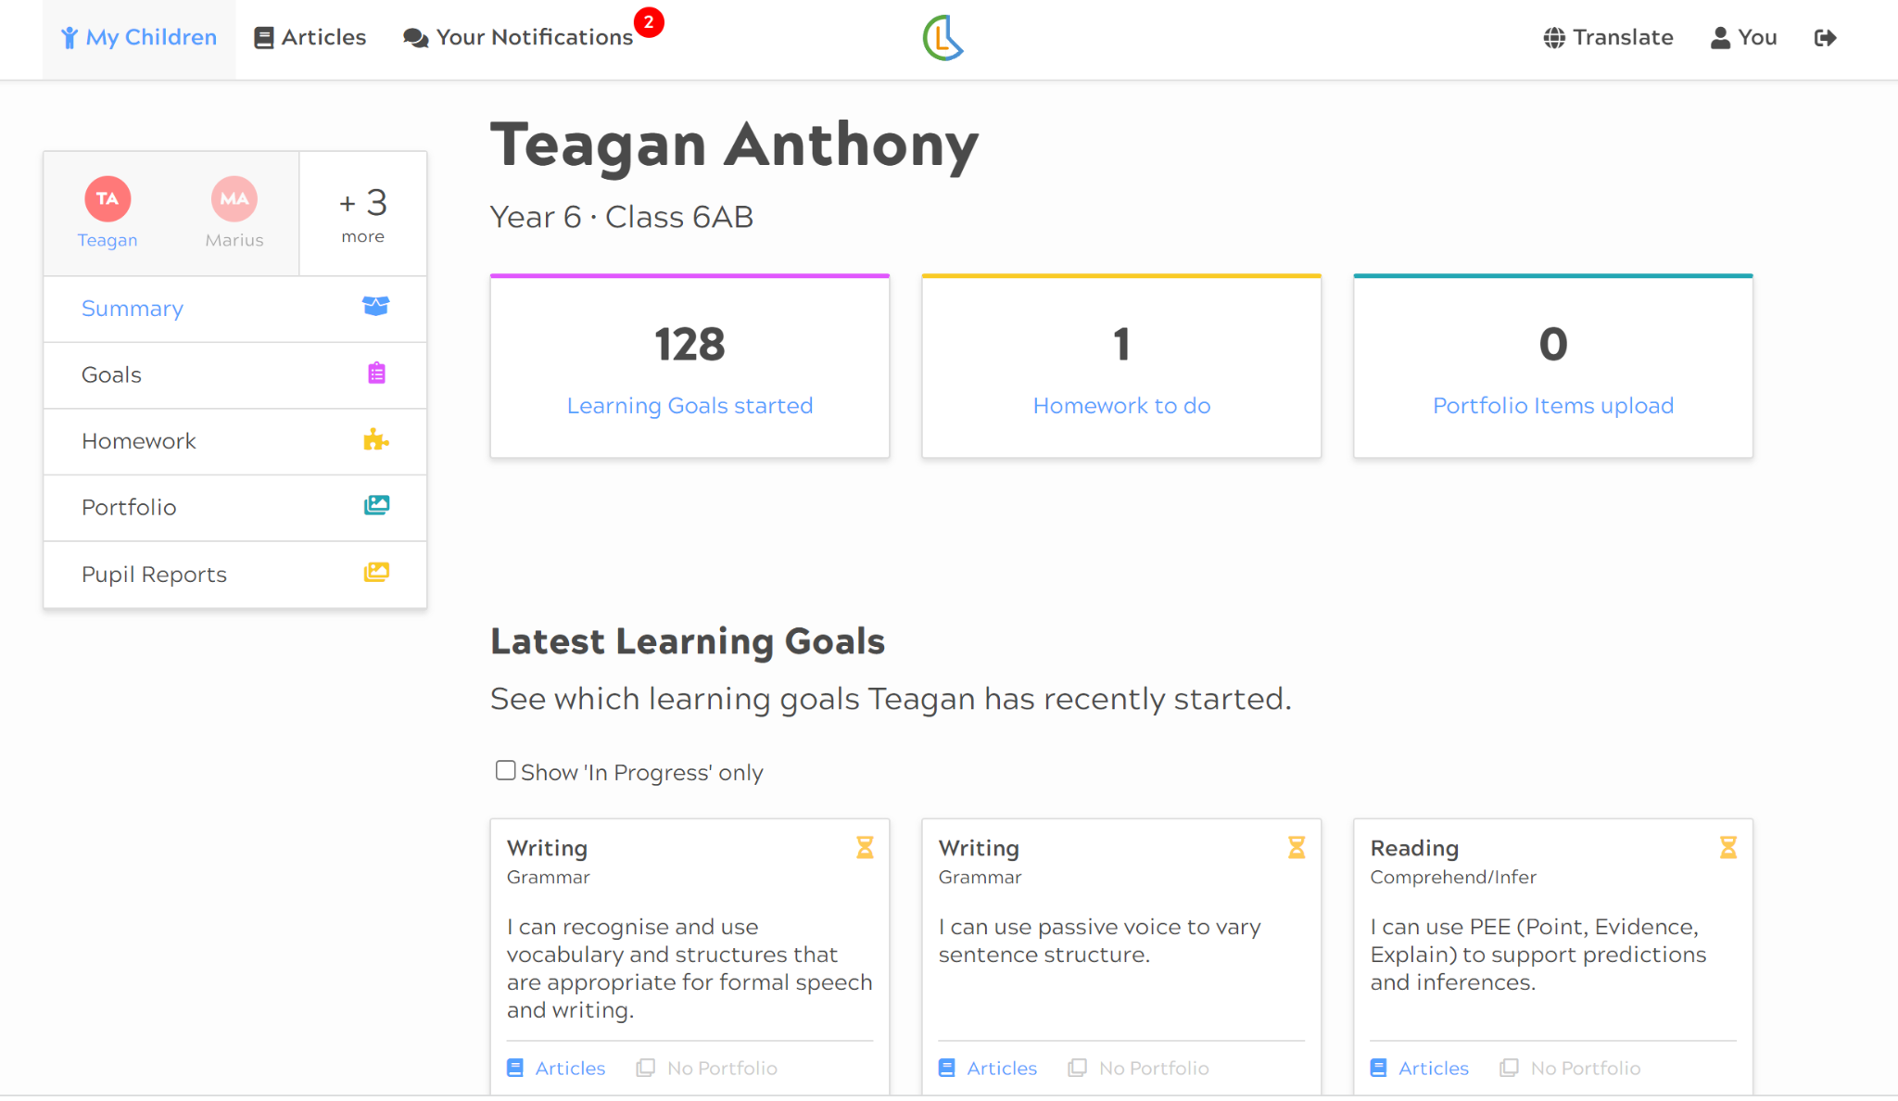
How do we access Ladders at Home?
EYFS View
Primary View
One login for multiple siblings across school, accessible from any device.

Slide 8
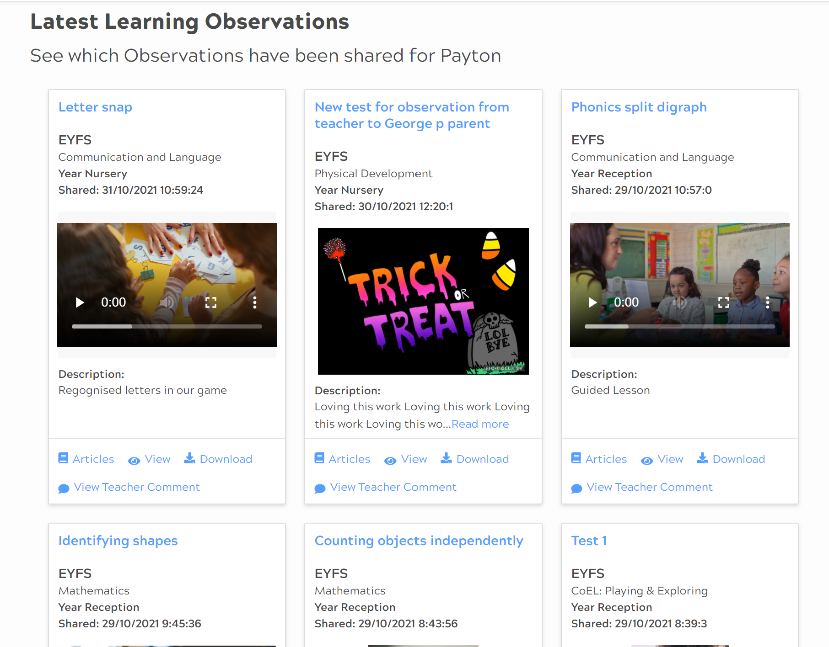
What information is shared with parents?
Observations of your child accessing the enabling environment in school.
We will continually share observations and updates on your child's learning.

Slide 9
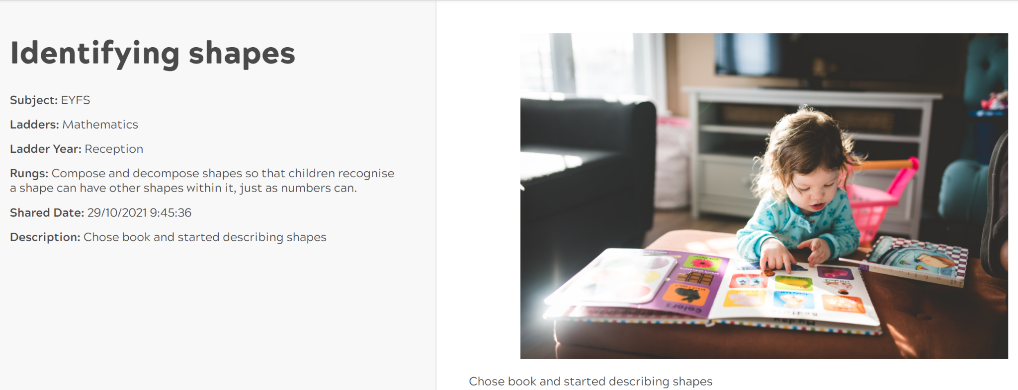
What information is shared with parents?
Observations are used in Early Years assessment to record significant moments of learning and build a picture of development over time.

Slide 10
How can observations open up conversations with my child?
Sharing observations with your child provides opportunities for celebrating learning, shows your interest in their learning and promotes a culture of communicating that can continue throughout their school journey.
Top Tips for talking to your child about observations:
Find a quiet time where your child has your full attention
Offer specific praise, “I can see you are concentrating here!”, “You look like you persevered and didn’t give up!”

Slide 11
How can observations open up conversations with my child?
Tell me about what you were learning here
Why did you choose that activity?
How did the activity make you feel?
Is there anything else you enjoy doing inside/outside?
Who do you enjoy learning with?
What will you practise tomorrow?

Slide 12
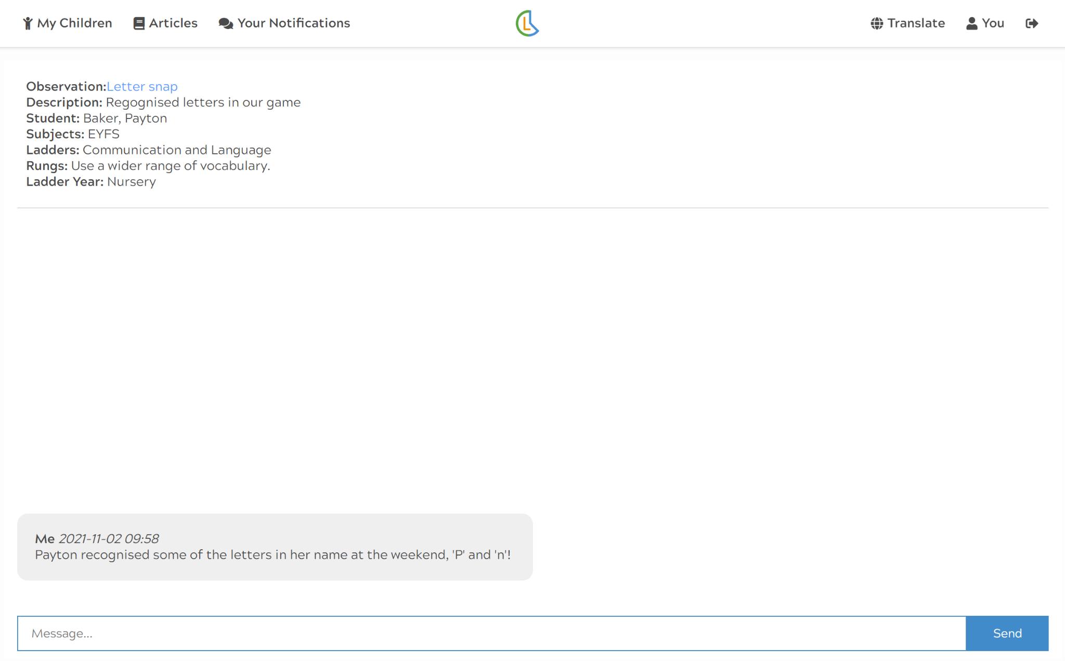
How can I communicate with the teacher?
As parents, you are the experts about your child and we value your reflections and feedback from home.
We encourage you to engage in two-way conversation with us in response to observation, pupil reports or evidence shared.

Slide 13
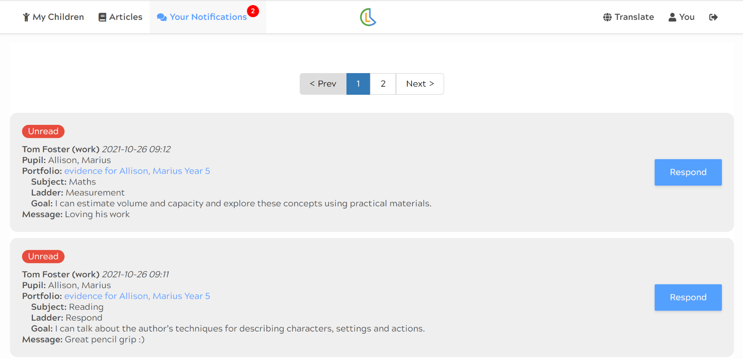
How can I communicate with the teacher?
Do we need to respond to every observation?
There is no expectation for parents to respond to every piece of information shared. Two-way communication exists to enable parents to respond to what they have viewed, ask questions or share details of development at home.

Slide 14
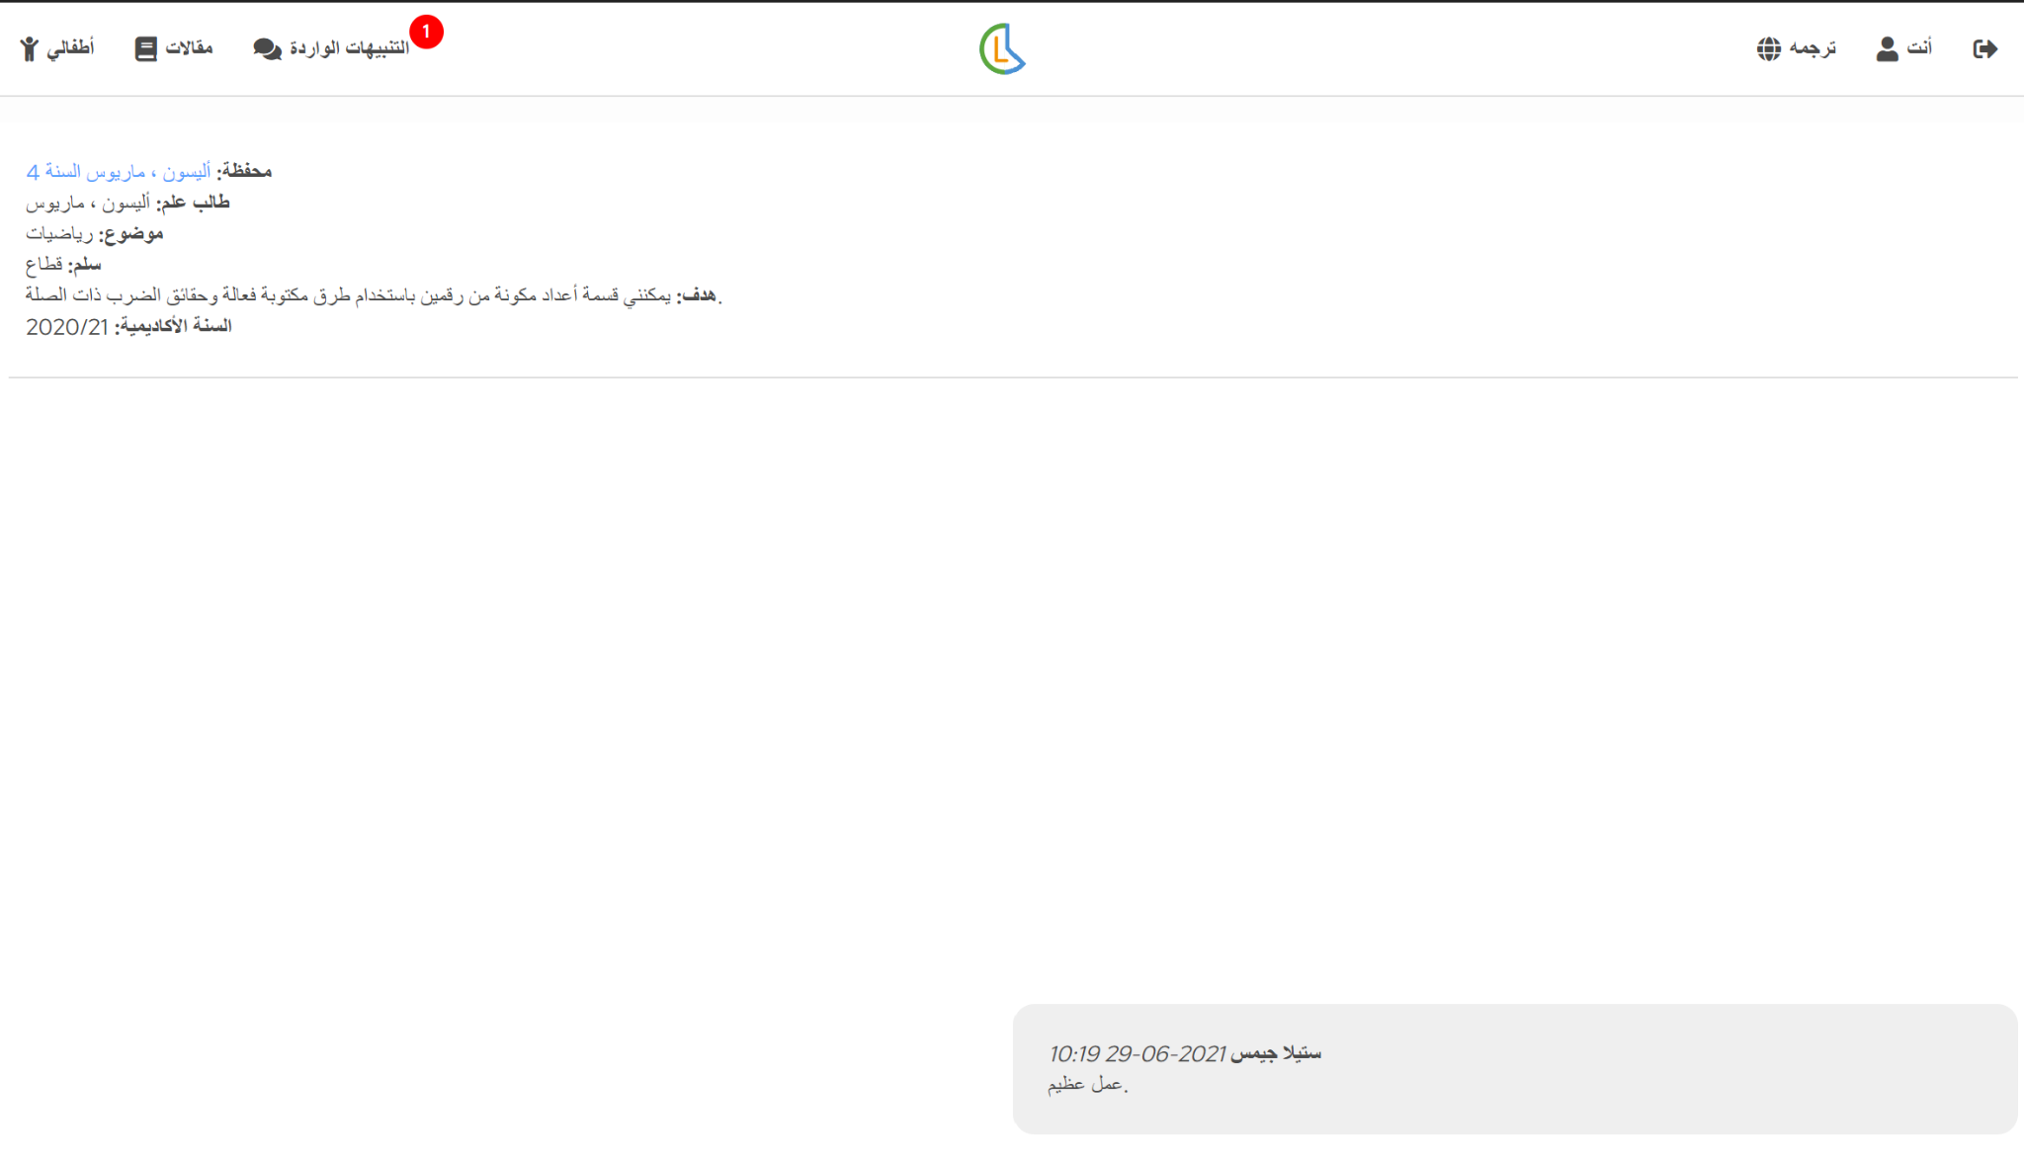
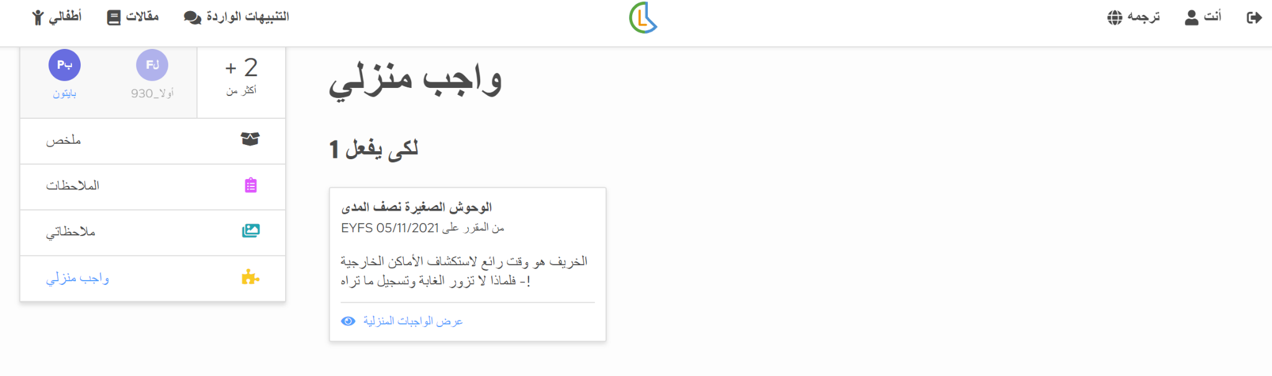
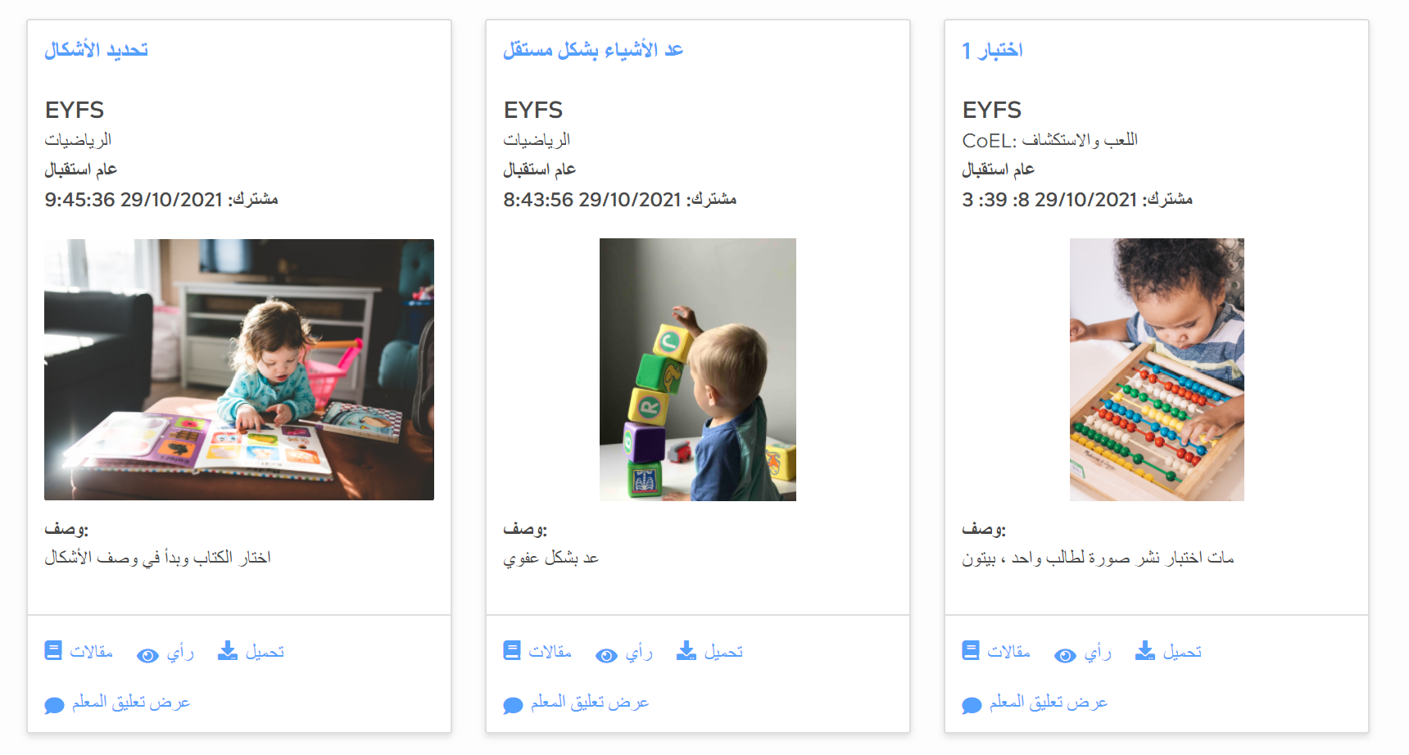
Are observations accessible for all?
All information is translated into 100+ languages

Slide 15
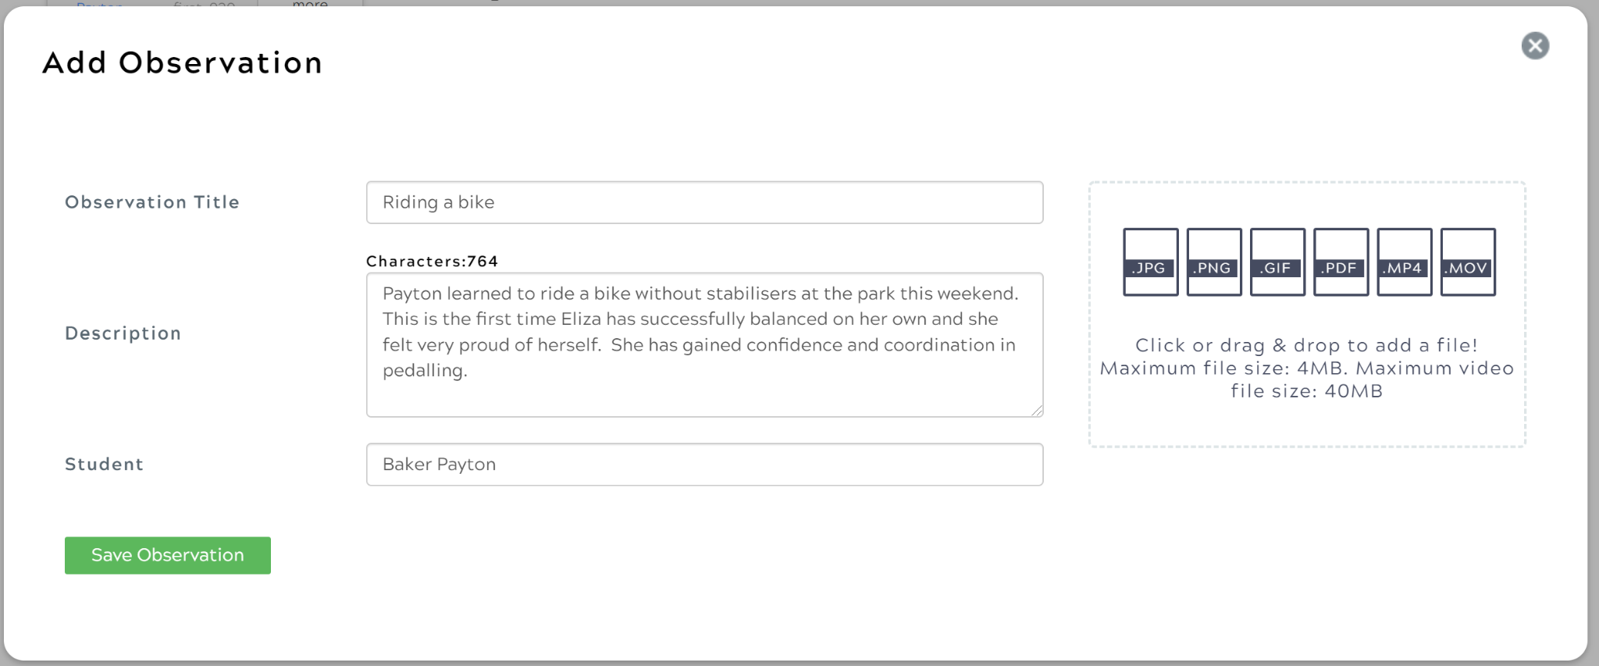
How can we communicate our observations from home?
Useful details to include in your observations:
What was your child doing in the picture/video/audio file?
Who were they doing the activity with?
Where is the observation taking place (seaside, garden, party etc.)
How did it make them feel?
Is this a new development or something they have shown you a number of times?

Slide 16
How is GDPR and Safeguarding managed using an online system?
Observations containing images/video files/audio will only be shared with adults registered to a child
Any safeguarding procedures around consent of photography/video in place in our school will apply to our use of Ladders at Home
School only invites adults with the email addresses provided by the parent to create an account

Slide 17
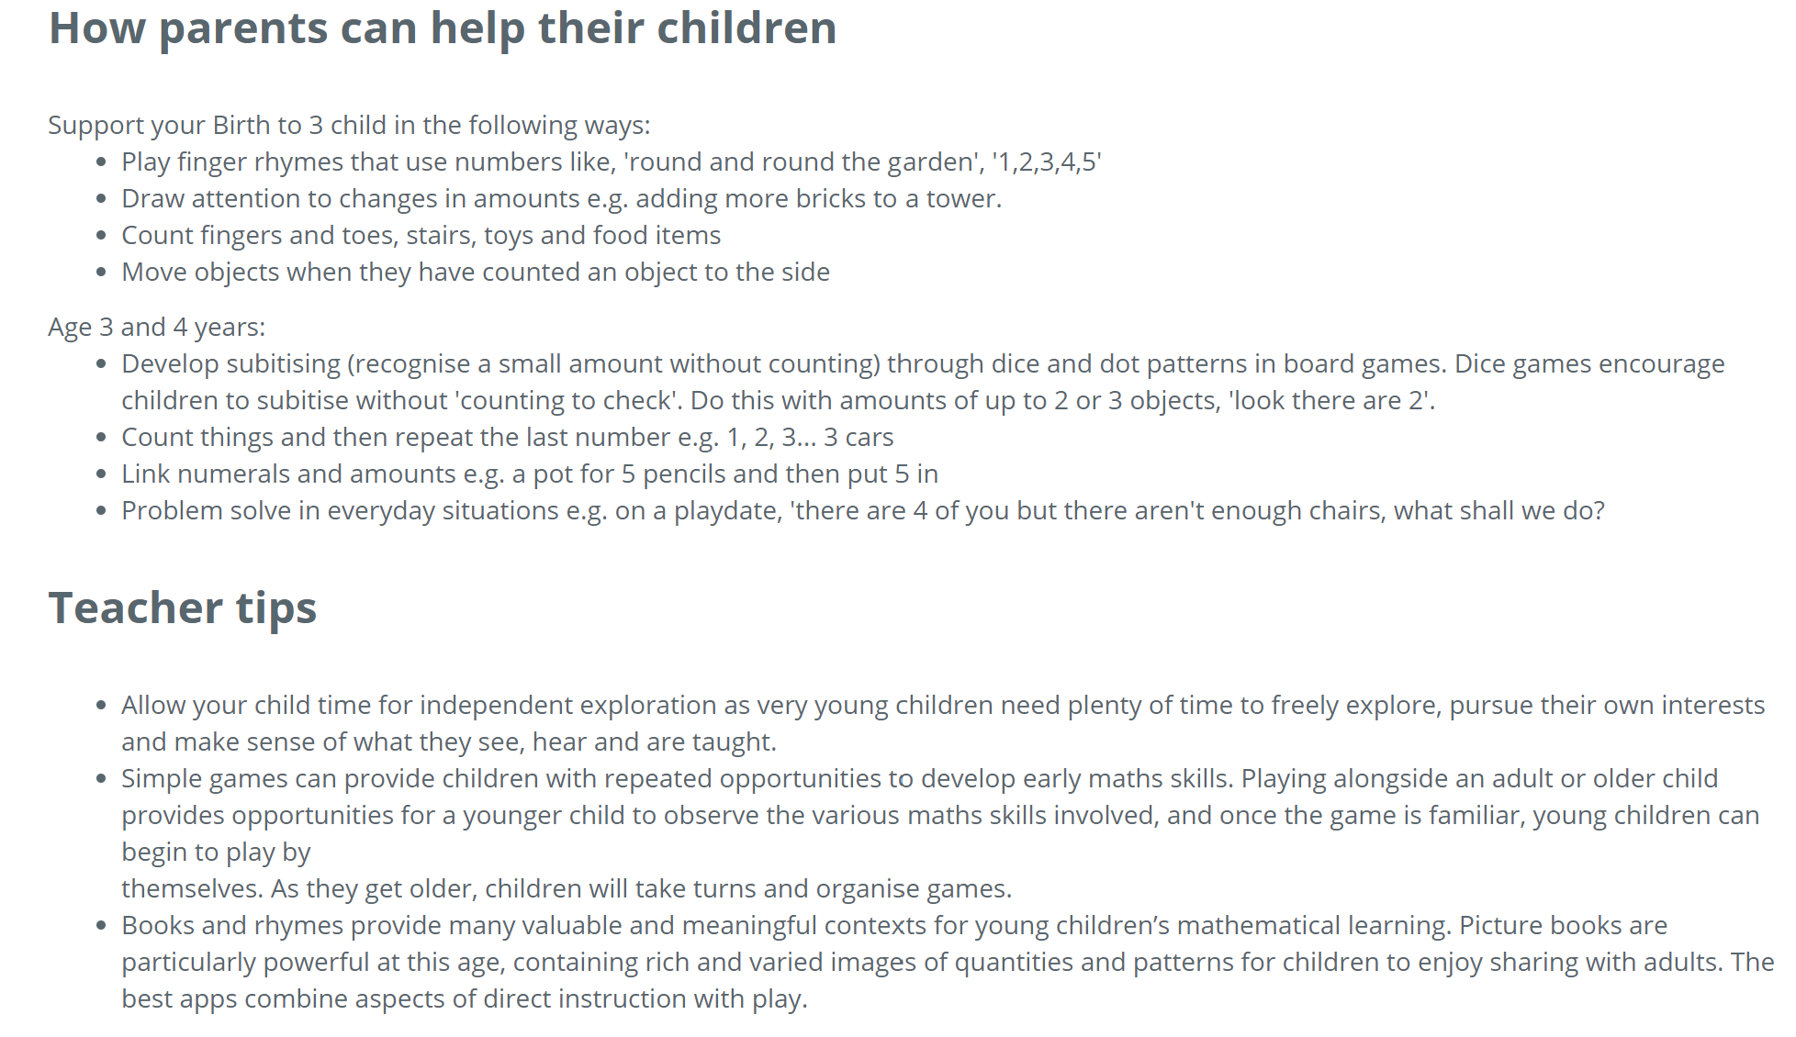
How can I help my child at home?
We will use key vocabulary, taken from the Early Years Framework, within our observations to communicate a child’s development.
Ladders at Home provides support articles for parents to unlock language around development in the Early Years.
Translatable in over 100 languages

Slide 18
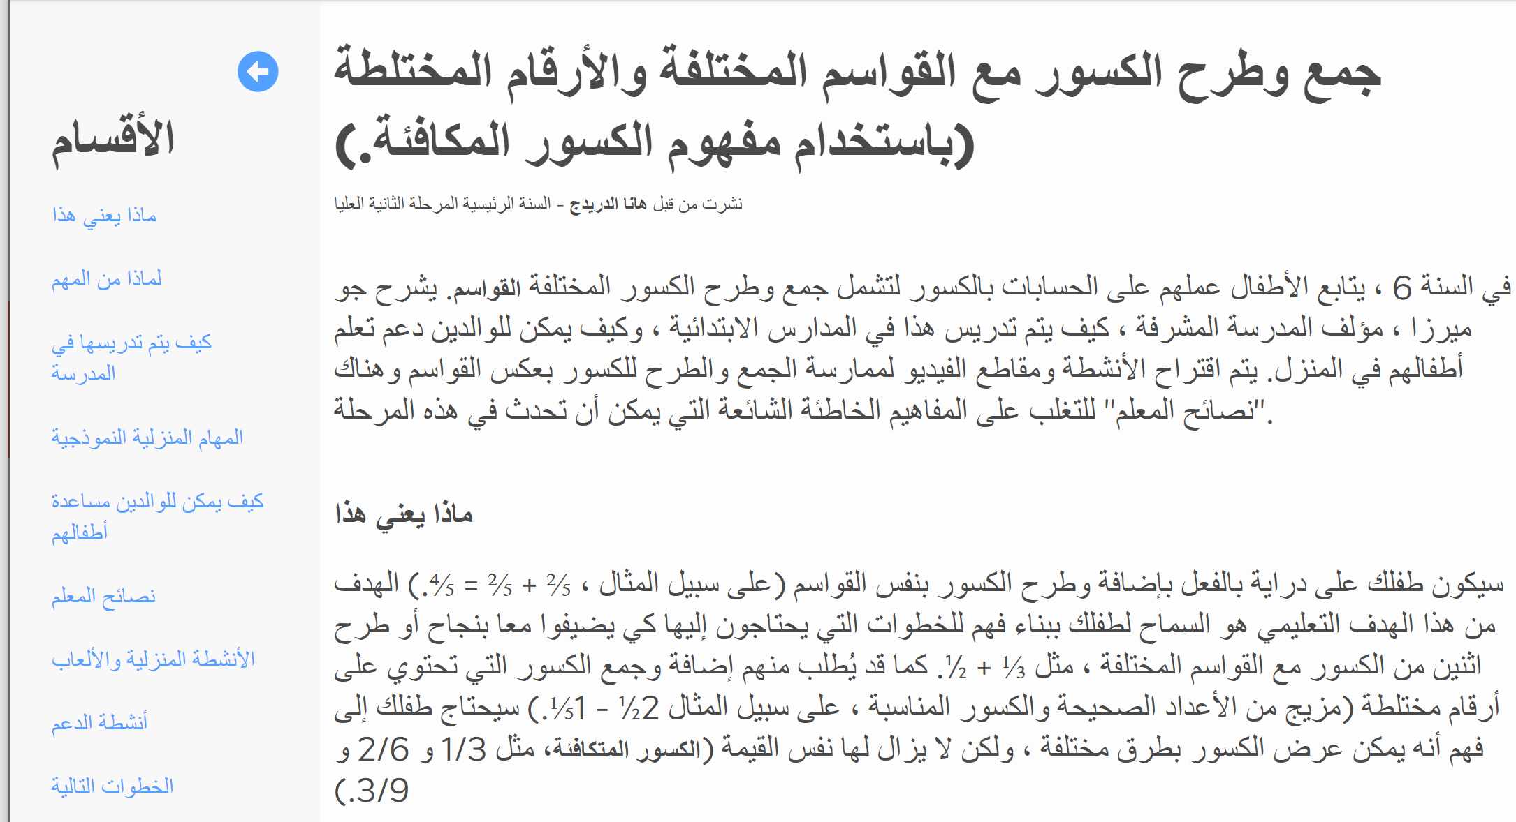
How can I help my child at home?
Articles share how development is promoted in the enabling environments in school and ideas to support you with tips and activities to support learning at home.
Translatable in over 100 languages

Slide 19
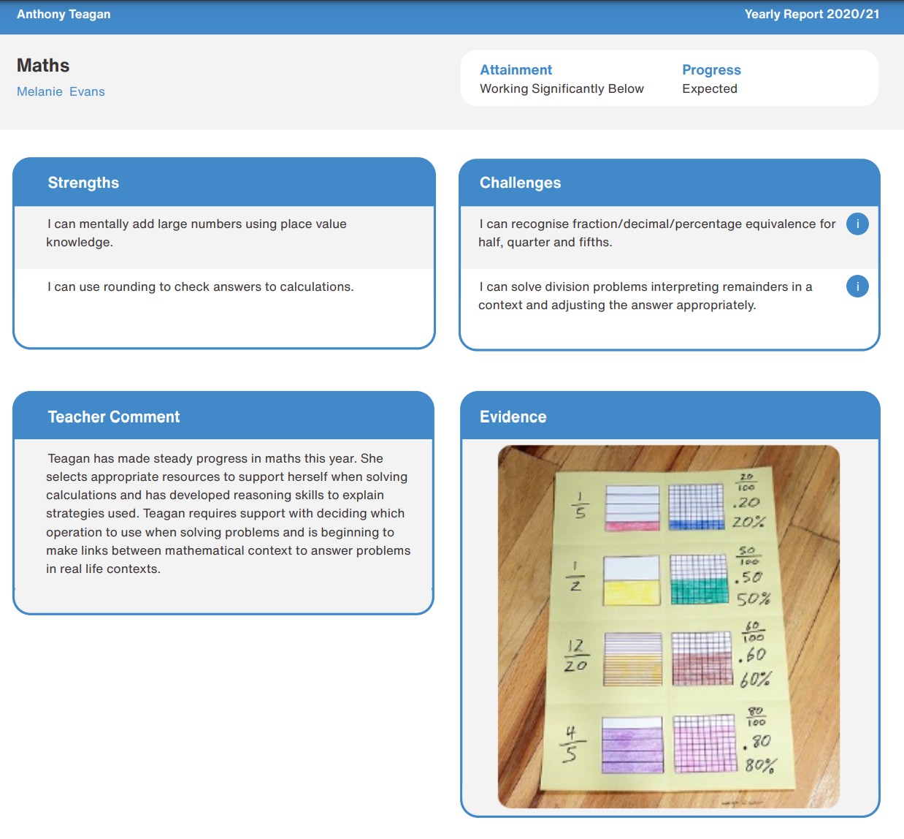
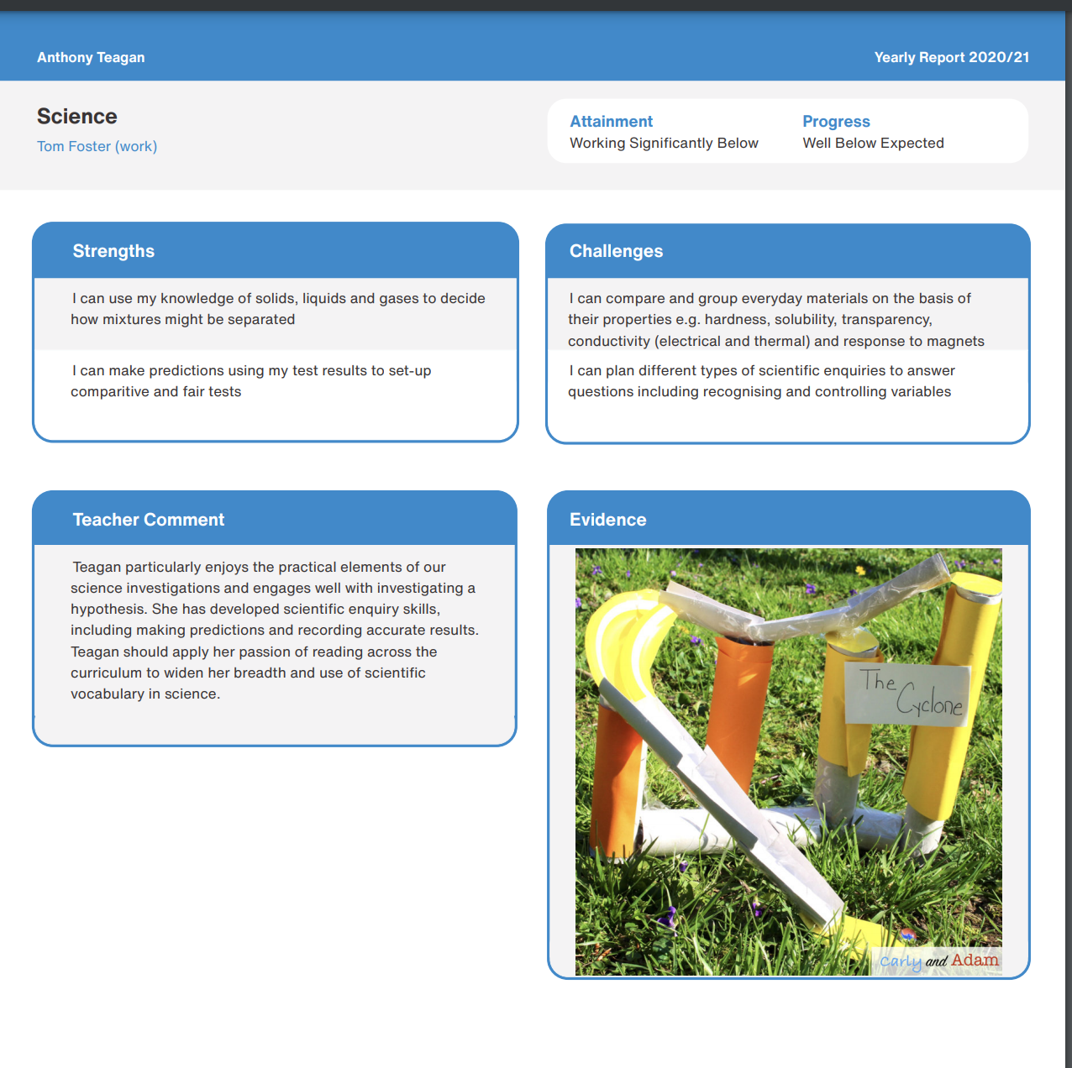
Where can I access my child’s report?
Ladders at Home brings your child’s report to life with the option for teachers to share photographs, videos and audio files.
Translation tools enable adults to view the report in any of the +100 languages, making reports accessible to all.

Slide 20
Improved transition
One consistent communication tool from EYFS to end of Primary.
Uninterrupted communication as your child moves between year groups for maximum progress in learning.
Accelerated Progress
All of the information about exactly what your child is learning and how to help guide learning at home.
Access for multiple adults
All adults involved in a child’s learning at home can have their own login to Ladders at Home- from parents to tutors.

Slide 21
What support will we have in using Ladders at Home?
We will send you a ‘Parents Guide to Ladders at Home’ which provides step by step instructions to using Ladders at Home.
Ongoing support with any issues or questions you may have can be directed to Miss Elsdon by emailing:
puffins@stmargaretsipswich.org
Or
admin@stmargaretsipswich.org
Liaise directly with Learning Ladders to resolve any technical issues from the login page.

Slide 22
Questions

