Slide 1


St Margarets CEVAP School

Slide 2
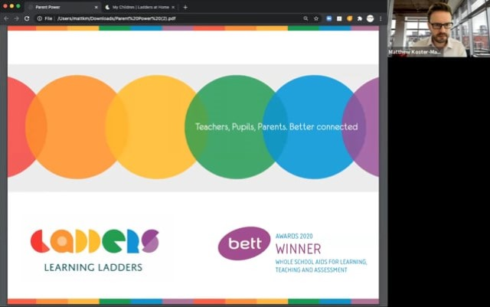

The rationale and reasons
behind choosing Learning
Ladders – Mrs Brown
Assessment Lead

Slide 3

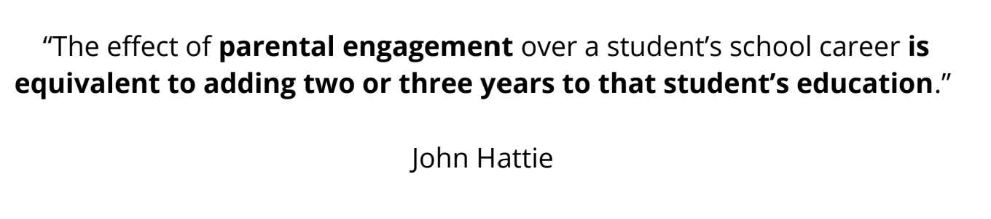
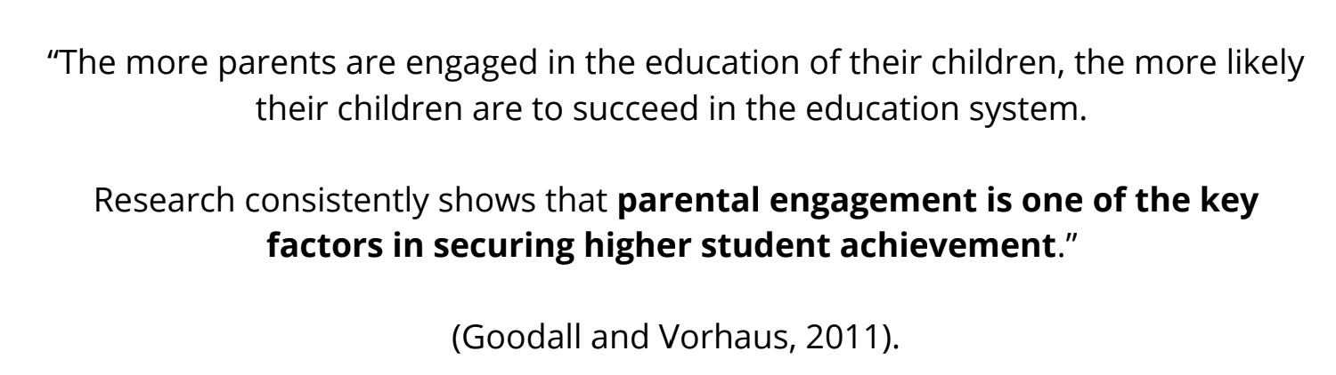
What does the research tell us?

Slide 4
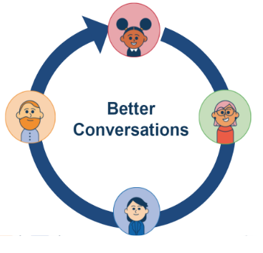
All adults working in partnership to know exactly where a child is in their learning and how to support learning in school and at home.
Two-way messaging
Shared, personalised learning goals
Personalised homework tasks
Bespoke individual student reports
Educational terms unlocked with support articles for parents

Slide 5
How do we access Ladders at Home?
One login for multiple siblings across school
Phase appropriate information shared for each stage of learning
Accessed via a URL on any device
Separate accounts for any adults involved in learning at home

Slide 6
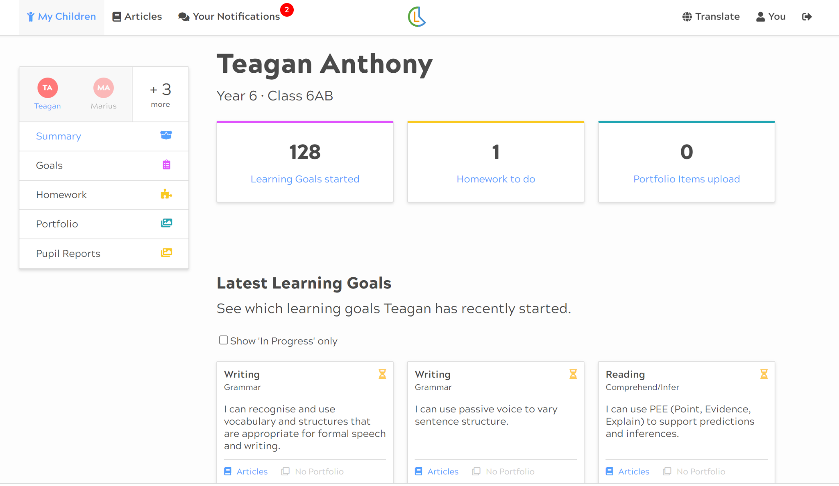
Primary View

Slide 7
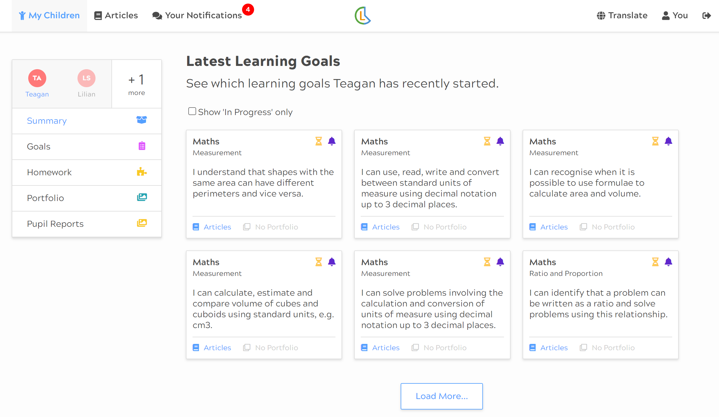
What information is shared with parents?
Receive ongoing information about your child’s progress against learning goals taught in school.
View the latest learning goals

Slide 8
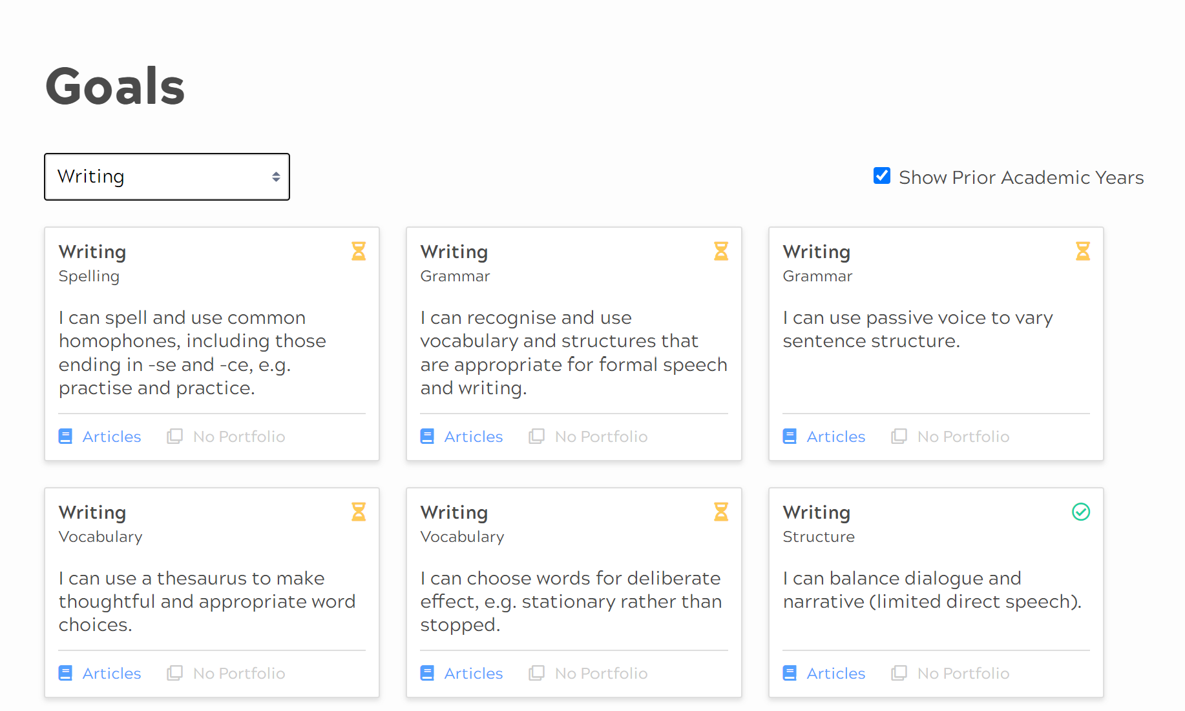
What information is shared with parents?
View all learning goals by subject

Slide 9
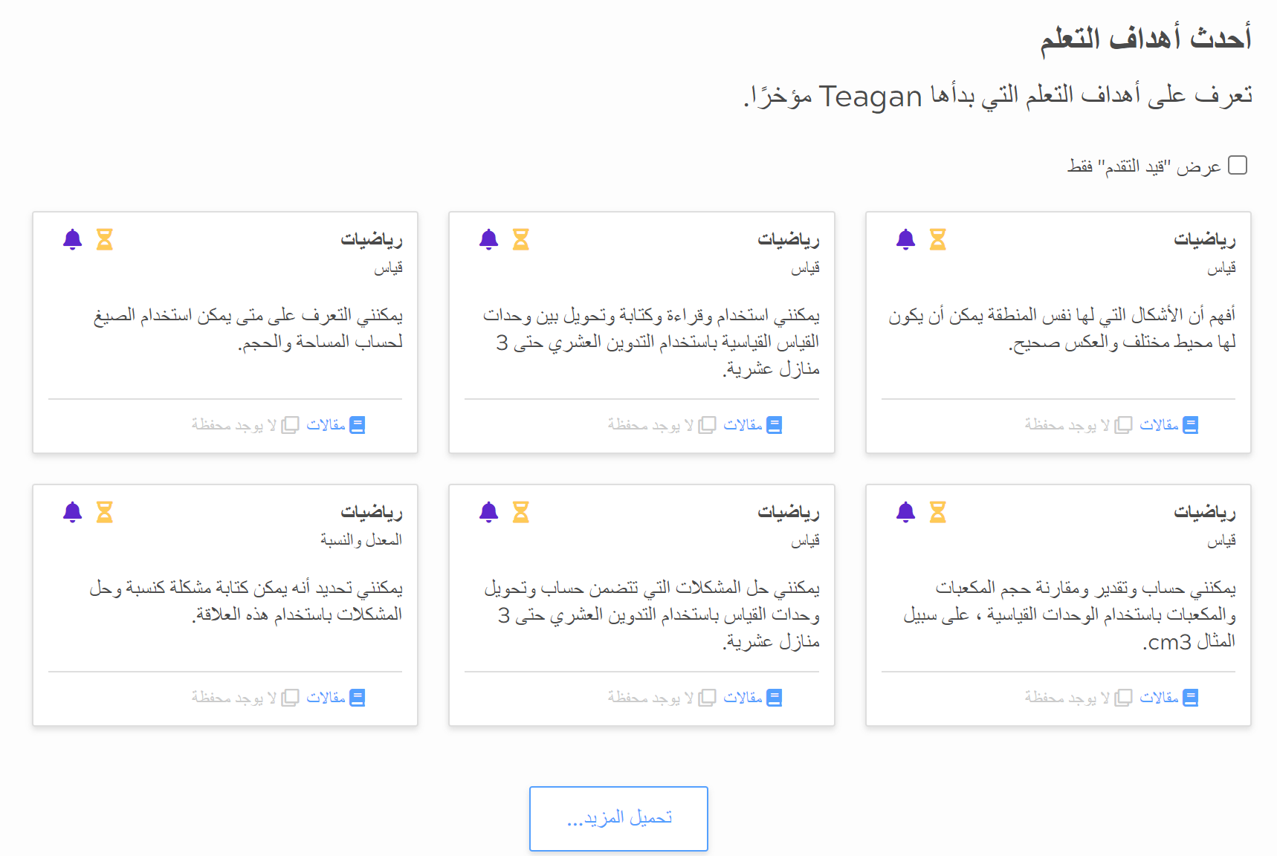
What information is shared with parents?
Information about your child’s learning is now more accessible with translation and accessibility tools
Accessible information on demand, from any device.
Translate learning goals into any of 100+ languages

Slide 10
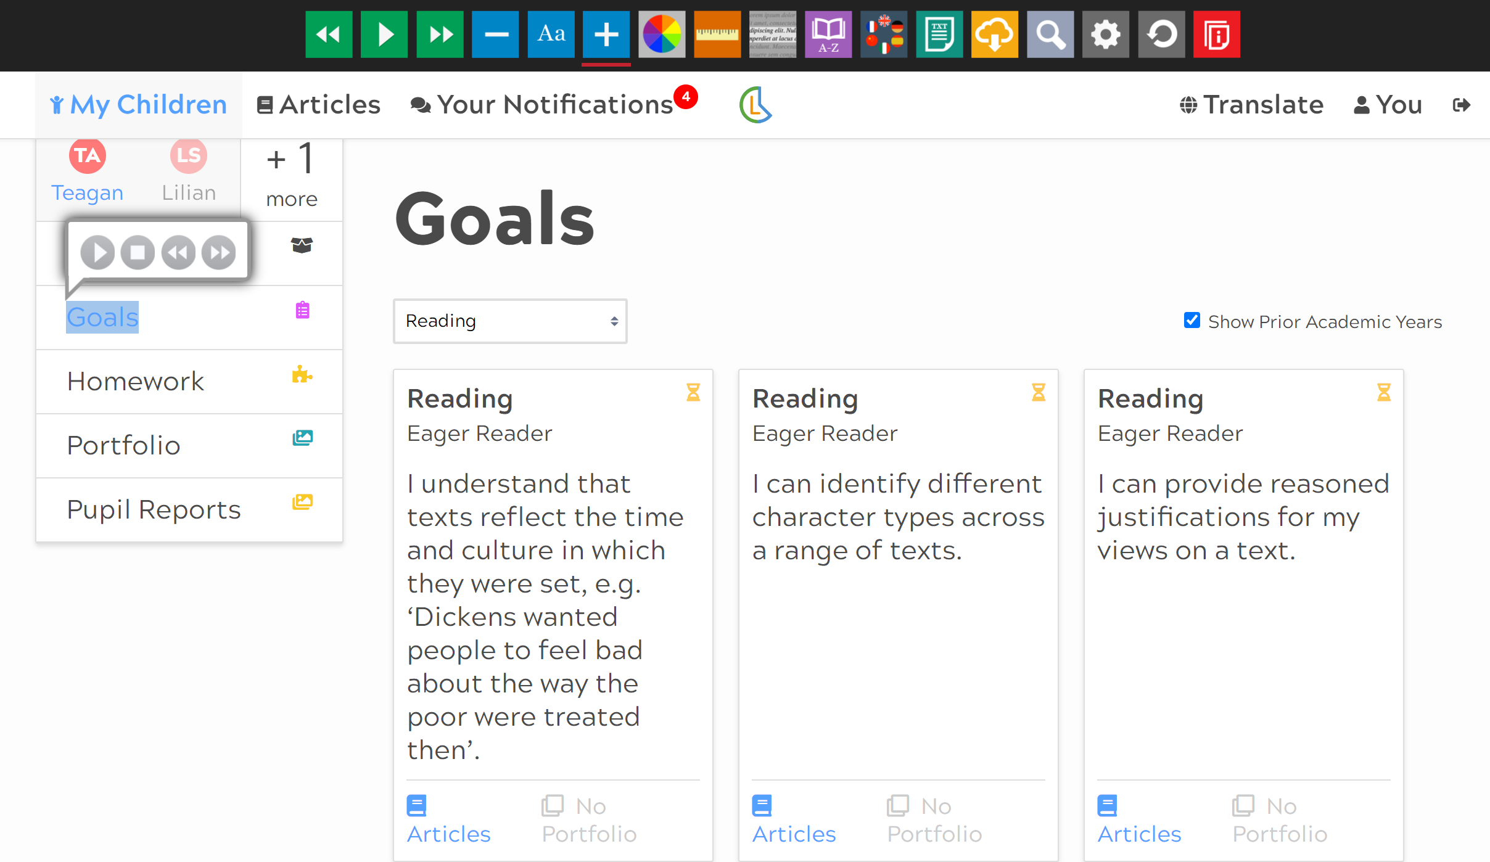
What information is shared with parents?
Information about your child’s learning is now more accessible with translation and accessibility tools
Accessible information on demand, from any device.
Translate learning goals into any of 100+ languages

Slide 11
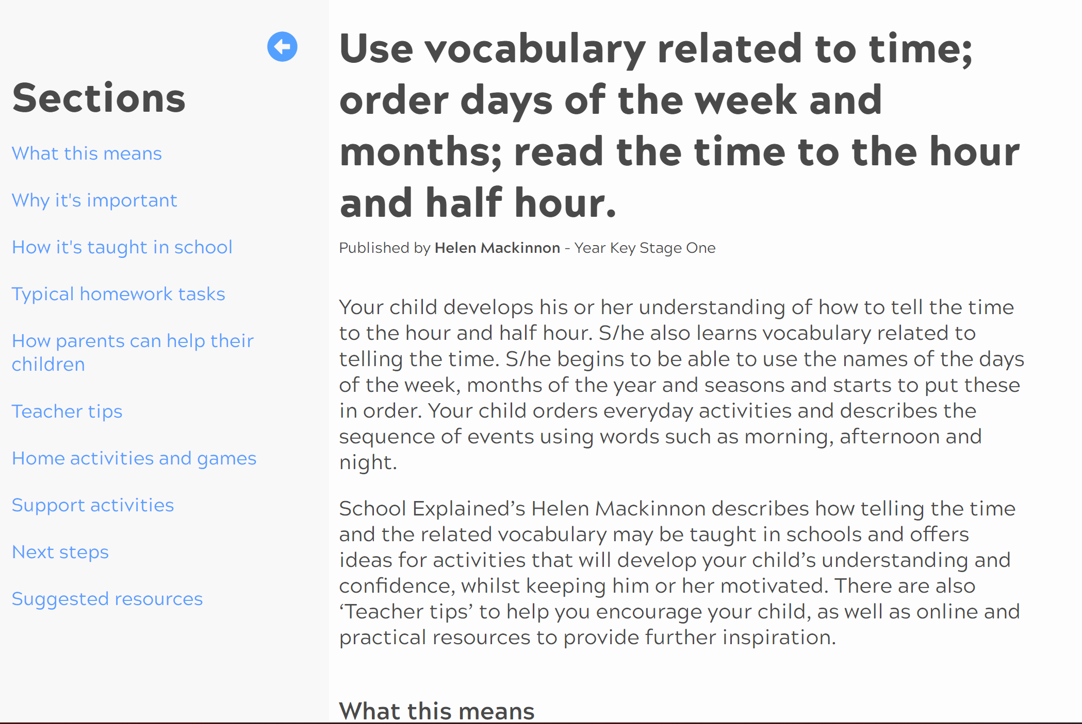
How can I help my children at home?
Ladders at Home provides explanations of exactly how, as a parent you can support learning at home.
Support articles, written by qualified teachers link to the learning goals for Maths. Articles provide explanations of educational terms, how learning is supported in school and activities to take part in at home.

Slide 12
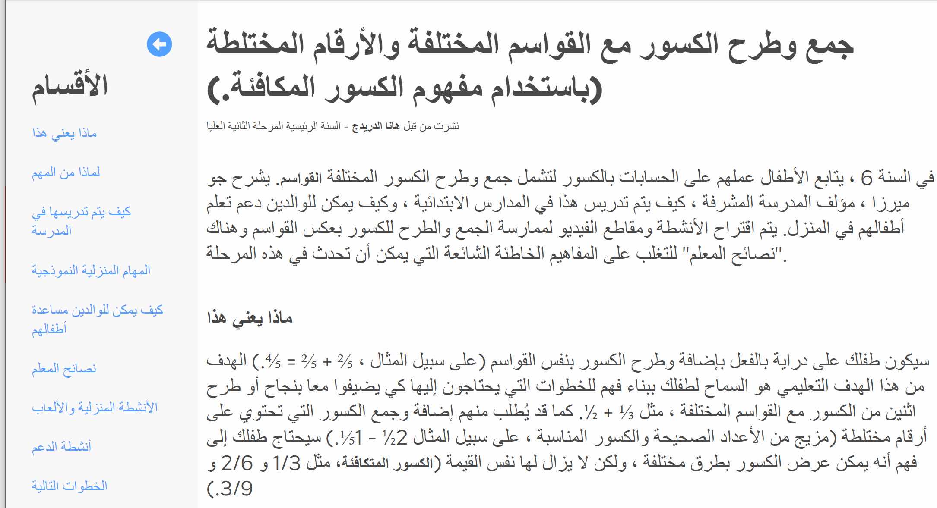
How can I help my children at home?
Schools have the option to write and publish their own articles, explaining the specific resources and approaches to learning used in your child’s classroom.
Translatable in over 100 languages

Slide 13
Create conversations about learning
Tell me about what you were learning here
Is there anything we can do together to help you?
How did the activity make you feel?
Is there anything else you enjoy doing inside/outside?
Who do you enjoy learning with?
What will you practise tomorrow?

Slide 14
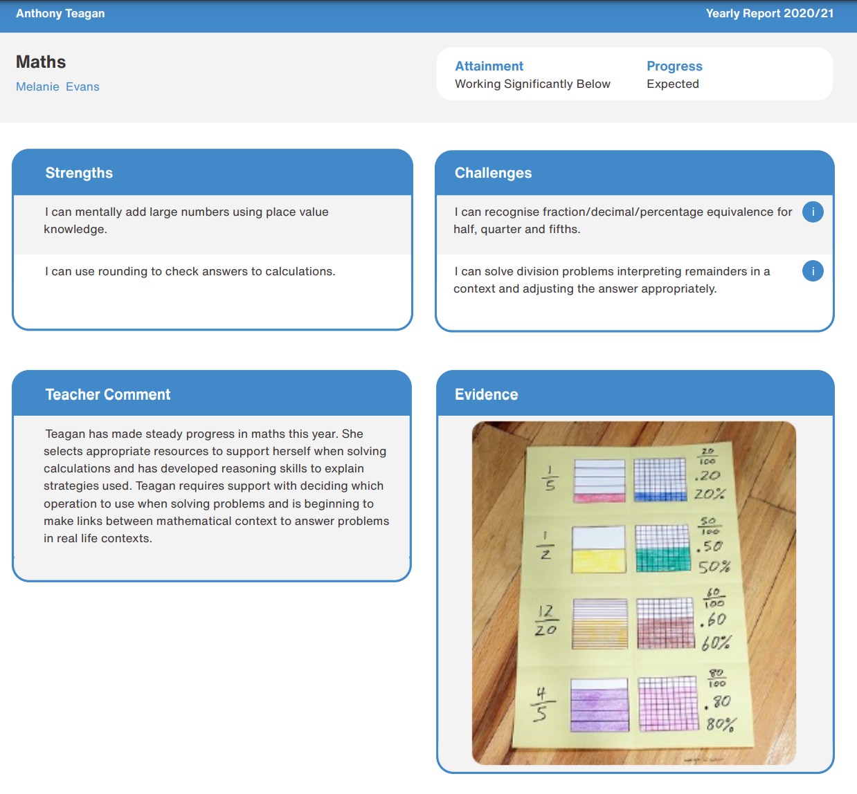
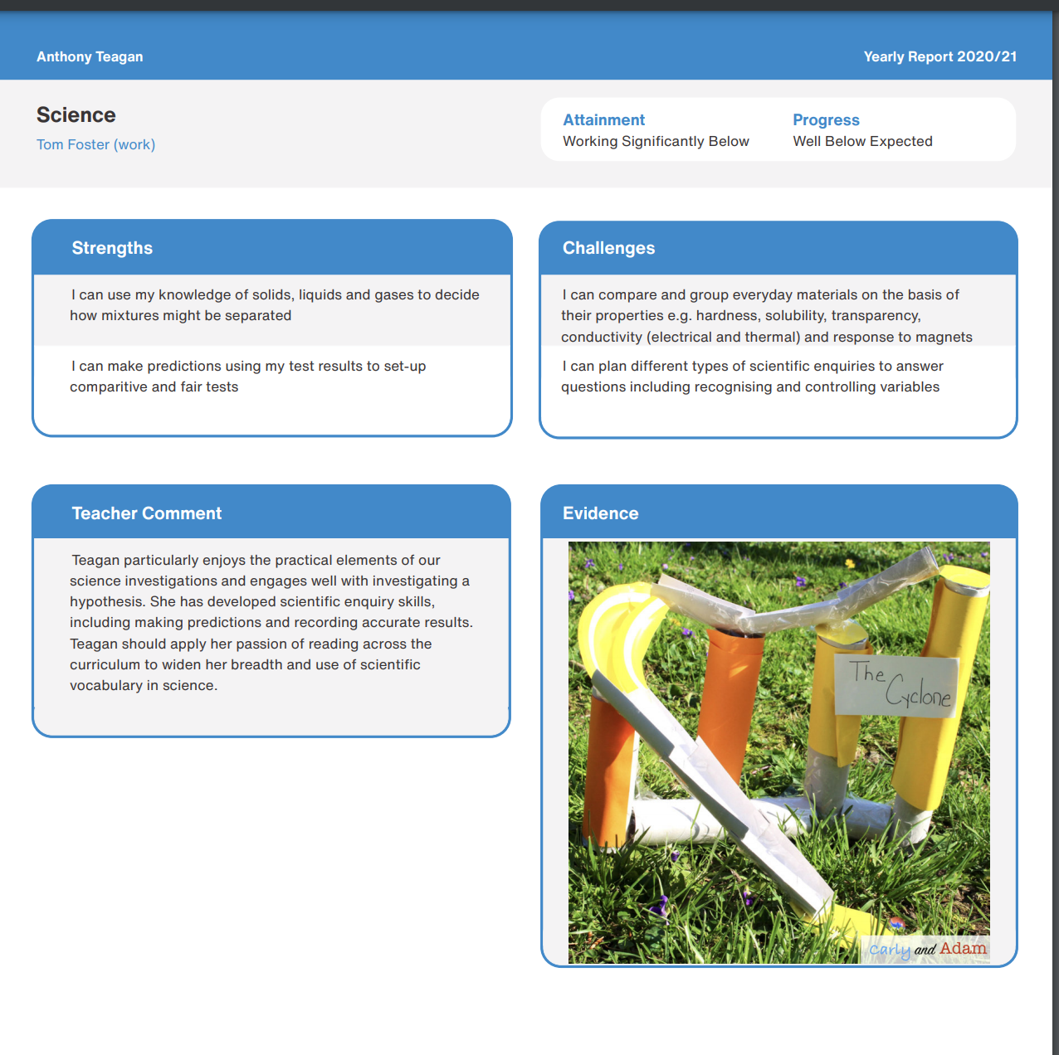
Where can I access my child’s report?
Ladders at Home brings your child’s report to life with the option for teachers to share photographs, videos and audio files.
Translation tools enable adults to view the report in any of the +100 languages, making reports accessible to all.

Slide 15
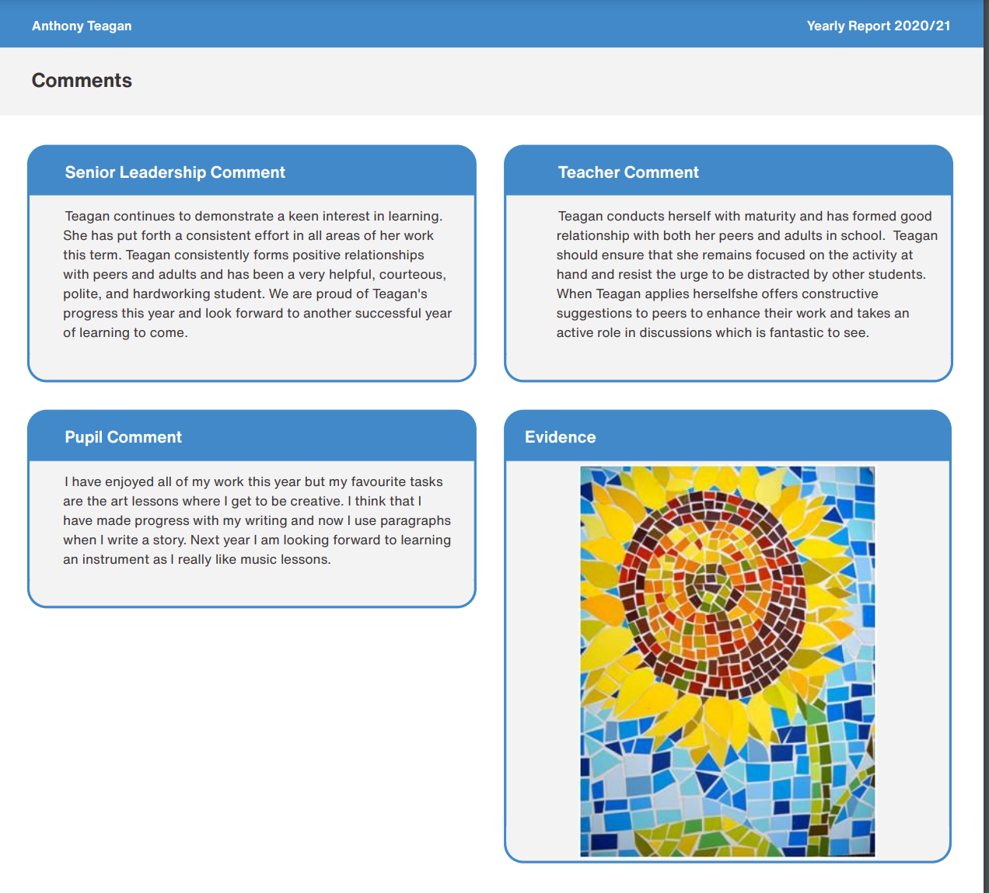
Where can I access my child’s report?
Opportunities for pupil voice and reflection
Parent feedback via two-way communication tools
Options to view the report digitally or download to print
Option for schools to share learning termly/end of year

Slide 16
Improved transition
One consistent communication tool from EYFS to end of Primary.
Uninterrupted communication as your child moves between year groups for maximum progress in learning.
Accelerated Progress
All of the information about exactly what your child is learning and how to help guide learning at home.
Access for multiple adults
All adults involved in a child’s learning at home can have their own login to Ladders at Home- from parents to tutors.

Slide 17
What support will we have in using Ladders at Home?
We will send you a ‘Parents Guide to Ladders at Home’ which provides step by step instructions to using Ladders at Home
Ongoing support with any issues or questions you may have can be directed to Mrs Brown by emailing:
whales@stmargaretsipswich.org or admin@stmargaretsipswich.org
All information and the video will be uploaded onto our school website.
We can liaise directly with Learning Ladders to resolve any technical issues.

Slide 18
Questions

