Slide 1


Meet the teacher
^{Wednesday 10th September 2025}

Slide 2
Teaching staff
Sharks:
Mrs Febvre
TA Mrs Bridges
Miss Andrews – Monday, Tuesday and Thursday afternoons.
Whales:
Mrs Izzard
TA Mrs Langbridge

Slide 3
Curriculum
English P.E.
Mathematics P.H.S.E.
Science Philosophy
History Art and Design
Design and Technology
Computing Music
R.E. Geography
French Life Skills
Latin

Slide 4
This term
Our learning is based around the First World War.
Our English writing, History, Art and Music will be linked to this theme.
Check the school website for our curriculum map and long term plan. (Click on Key information then curriculum)

Slide 5

Reading.
Please continue to hear your child read regularly, it is important for vocabulary
understanding.
Please see the recommended book list for the types of texts you can read with
Your child.

Slide 6
P.E.kit
White T shirt
Green shorts
Trainers
Tracksuit in navy, black or grey
P.E. will be on a Friday afternoon lead by Mr Durrant.
Please come to school in your P.E. kit

Slide 7
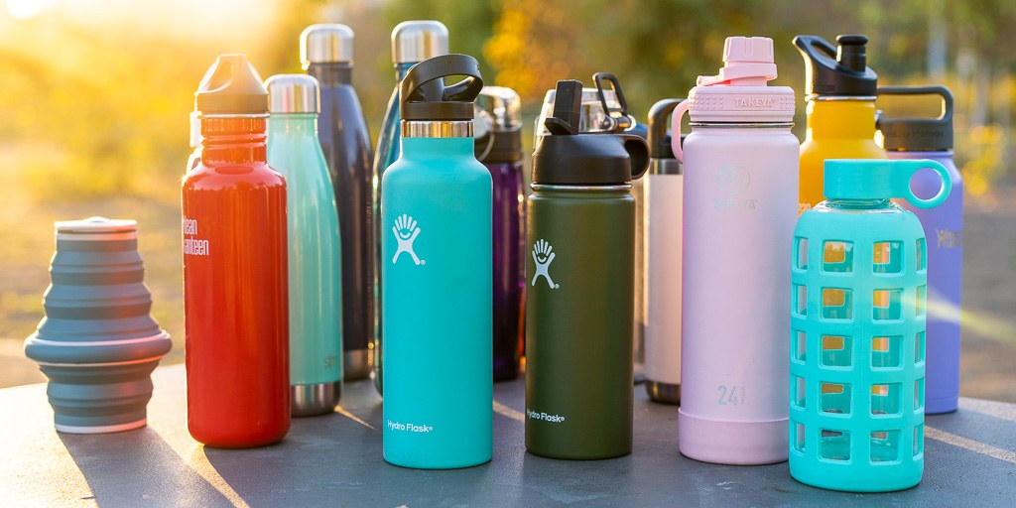
Water – Make sure your child has a bottle to bring into school everyday.

Slide 8
S.A.T.S.
There will be a meeting for the parents in the New Year to explain the S.A.T.S. tests.

Slide 9

Homework
Homework is provided weekly. It will be the same across both classes and will be
a list of spellings
Mathematics
English
Given out on a Wednesday and
collected the following Wednesday

Slide 10
Parents Evenings
There will be an opportunity this term to meet your child’s teacher.
Tuesday 17th October 3:30 – 6:00pm
Thursday 19th October 4:30 – 7:30pm.

Slide 11

Supporting your child – Help your child to become more independent this year and responsible for themselves and belongings. If you want to complete any additional support at home we recommend the CPG work books or revision guides.

Slide 12
Events
Residential visit 25th September – 29th September
Visits to the war graves and Cenotaph – Autumn term
Cinema visits – Autumn term
Pantomime - December
SATS –further information will follow about these national tests.
Activity week – June/July
School production - July

Slide 13
Aims
We want your child to:
Become a confident student
Develop a love of learning
Become ready for high school
Reach their full potential

Slide 14
Concerns or worries
If you have a worry or concern about your child, you should firstly contact the class teacher via email.
sharks@stmargaretsipswich.org
whales@stmargaretsipswich.org
If you need to escalate your query for any reason, please contact Mrs Febvre the Key Stage Two Assistant Headteacher, either by email or request a phone conversation.

Slide 15
If you need to contact your child’s teacher please can you email on sharks@stmargaretsipswich.org whales@stmargaretsipswich.org
Emails will be checked regularly between the hours of
8 a.m. and 5 p.m. Monday to Friday.
We will be happy to answer any questions via email or we will phone you if it is necessary.
You may not always get an immediate response so if it is something urgent or a change of who is picking your child up that day, please phone the school on
01473 251613

Slide 16
Norfolk Lakes
What to bring – See kit list.
Medicines – Please bring into school in a plastic tub clearly named and labelled with dosage.
No mobile phones or electronic devises
Staff accompanying children – Mrs Febrve, Mrs Brown, Mrs Elliott-Duff, Mrs Bridges, Mr Durrant, Ms Dozzel and Mrs Barnes.
Children remaining at school will have a project week and be taught by Miss Andrews, Mrs Taylor

