Slide 1
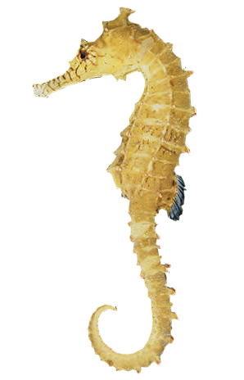
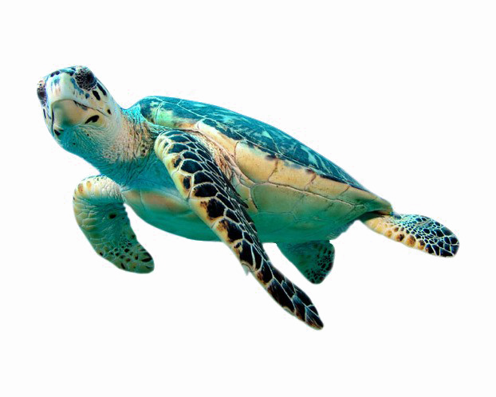
WELCOME TO YEAR 3
Miss Benjamin and Miss Ross

Slide 2
STAFF IN YEAR 3
Miss Benjamin- Teacher of Sea turtle Class
Mrs Kamboh-Teaching Assistant of Sea turtle Class
Miss Ross- Teacher of Seahorses Class
Miss Pippalla- Teaching Assistant of Seahorse class
Mrs Joshua - Teaches Seahorses on Monday afternoons
Mrs Gray– Teaches Sea Turtles on Tuesdays
Mrs Gower- Teaches Music
Nash- Teaches PE
Miss Benjamin – Is the phase lead of Year 3 and 4
Any message can be given to the office or emailed to seaturtles@stmargaretsipswich.org or seahorses@stmargaretsipswich.org

Slide 3


KS1 TO KS2 CHANGES
No snack is provided. This means if your child wants a snack you need to provide this. A piece of fruit or vegetables.
No afternoon playtime. Children will still receive a morning playtime and their lunchtime play.
Blazers and ties are now part of the uniform
Weekly homework is given on reading (at least 3x a week), spelling (a list of the words we are practising in class) and mathematics. This will be set on Thursday and expected in the following Thursday. A record will be kept of completion of Maths and Reading.

Slide 4
READING IN YEAR 3
Reading book and diaries sent home – come to school every day
Reading comprehension lessons
Library books
Signing diaries – please sign when you hear your child read
Own books brought in- Please make sure to name these!

Slide 5
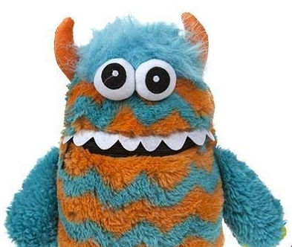
WORRY BOX
Both classes have a worry monster
Well-being team - can provide extra support in a pastoral capacity. The team have a red post box on the playground where children can request support or express concerns and can be referred by the class teacher or parents
Mrs Richards – hslo@stmargaretsipswich.org

Slide 6
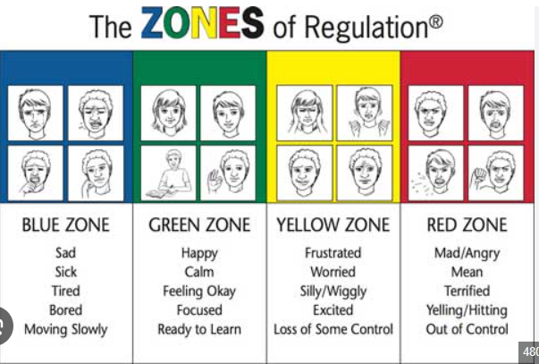
ZONES OF REGULATIONS
The Zones of Regulation is a whole-school strategy, which enables children to be able to identify their own emotions, whilst supporting them with strategies to self-regulate. These include: use of language / application of colours to feelings / considering their response to these feelings and calming and regulating activities. It is delivered through regular whole-class teaching sessions, as well as through more bespoke interventions – in response to individual need.
Each classroom has an area with each zone visible and a reset box available

Slide 7
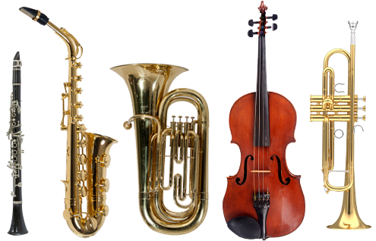
MUSICAL INSTRUMENT TUITION
If your child is doing music please check parentmail for the dates and timings. If your child has extra music tuition during lesson time, they may occasionally need to bring home pieces of work to complete or finish at break/lunchtime. It is the class teachers decision whether the child needs to bring work home.

Slide 8
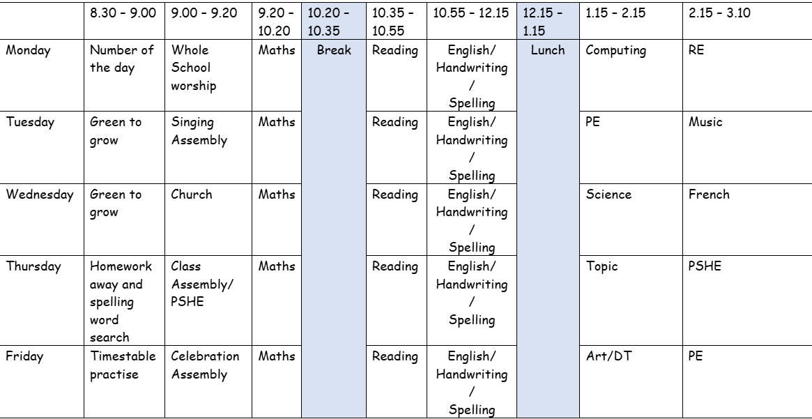
WEEKLY TIMETABLE - YEAR 3
This means on Tuesdays and Fridays children need to come to school in their PE kit.

Slide 9
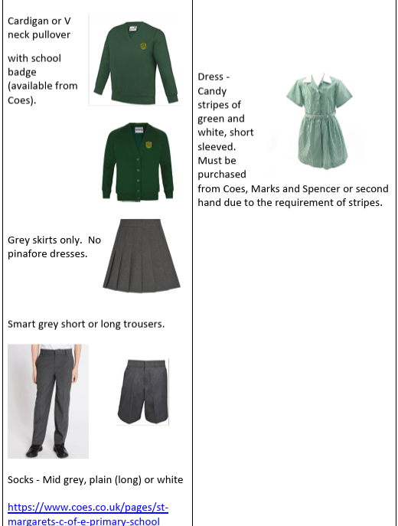
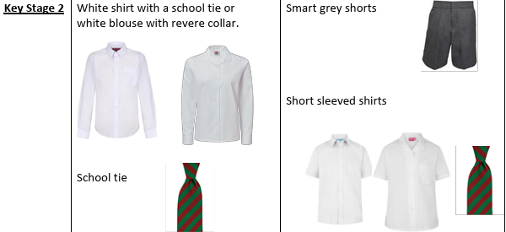
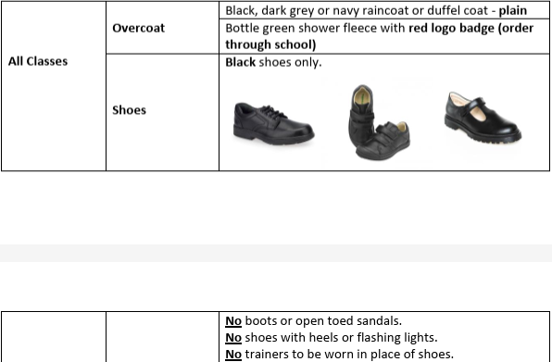
UNIFORM

Slide 10
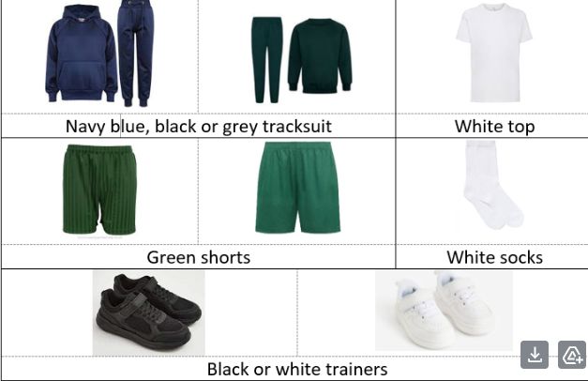
PE UNIFORM
PE uniform needs to be worn on Tuesdays and Fridays for our PE lessons.

Slide 11
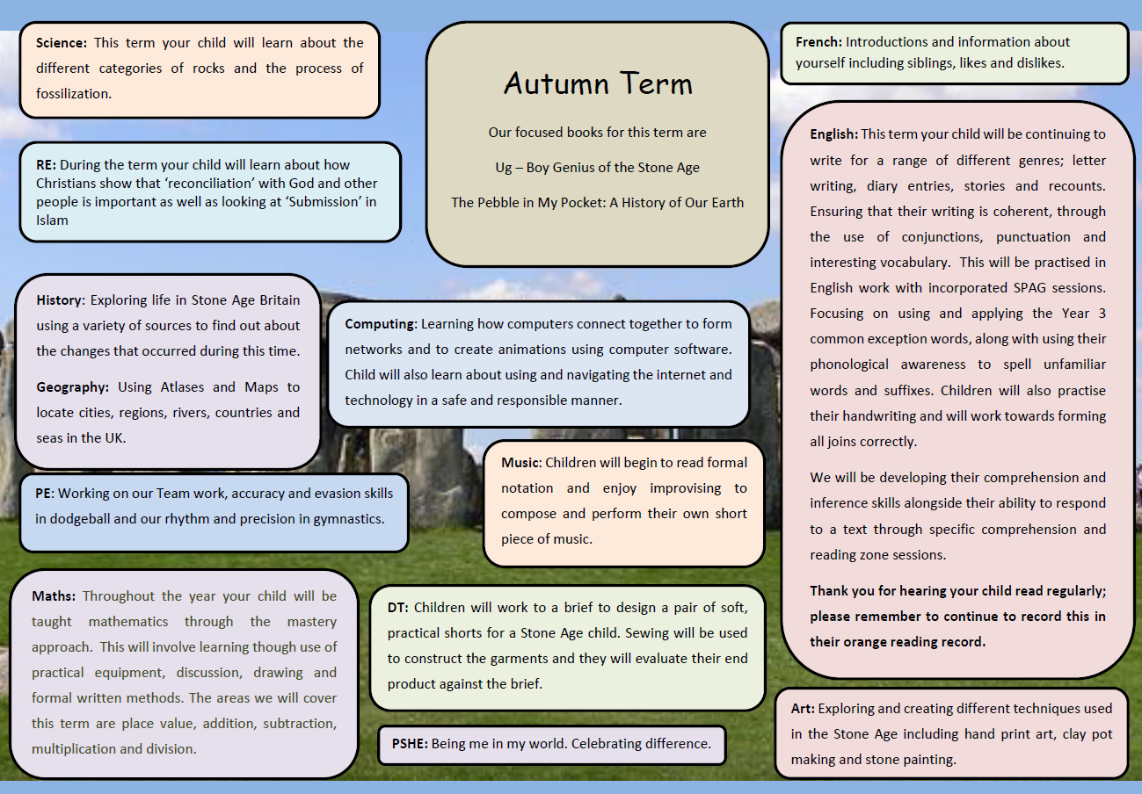
WHAT ARE WE STUDYING THIS TERM?
This is all available to access and print on the school website. Children---
Class pages– Seahorses or Sea Turtles

Slide 12
ANY QUESTIONS?

Slide 13
THANK YOU FOR COMING ALONG TODAY.
ANY QUESTIONS PLEASE ASK US NOW OR EMAIL:
SEA TURTLES- SEATURTLES@STMARGARETSIPSWICH.ORG
SEAHORSES- SEAHORSES@STMARGARETSIPSWICH.ORG
PLEASE NOTE WE WILL REPLY DURING OFFICE HOURS.

