Slide 1


Welcome to Year 1

Slide 2
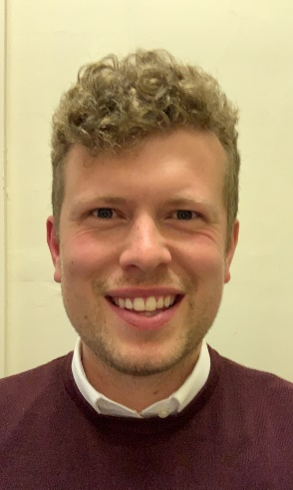
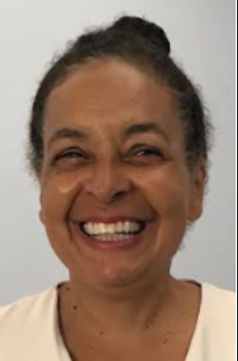


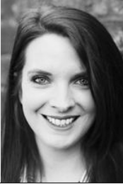
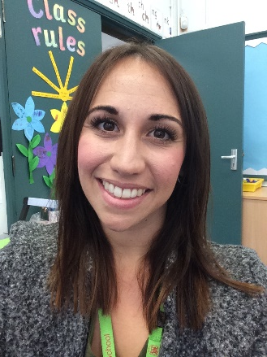
Meet the Team
Tigers:
Mr Peck– every day
Miss Joshua - Tuesday Mornings
Miss Dozzell supporting every morning.
Lions:
Mrs Mayhew – Monday and Tuesday
Mrs Curtis – Wednesday, Thursday and Friday
Mrs Keable supporting most of the week.
One of us will be on the playground to greet you.

Slide 3

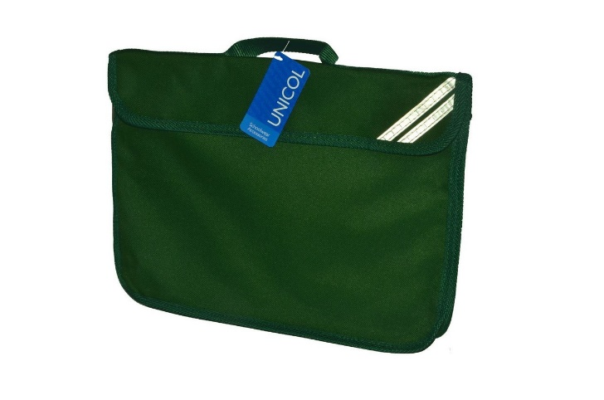
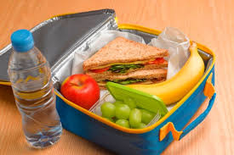
What to bring to school
Green book bag
Water bottle
Packed lunch if appropriate (this must be named). We are a nut free school.
Snack is provided, however if you wish to bring your own please ensure it is fruit or vegetables.
School arrival is between 8.30 and 8.40am – Please wait at the playground gate until it is open, then follow the playground markings to drop your child with the appropriate teacher. (Please be prompt)
School ends at 3.10 – Please follow the same morning procedure
*Please ensure EVERYTHING is labelled*

Slide 4
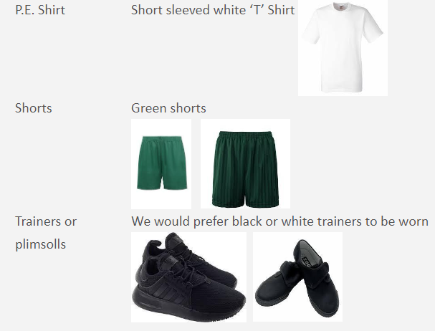

PE
PE is on Tuesdays and Thursdays
Children MUST come to School in their PE kit on the day they have PE.
Children with long hair must wear it tied back and no jewellery can be worn.
Navy, grey or black tracksuit for cold weather
*Please ensure EVERYTHING is named*

Slide 5

Communication with Class Teachers:
If you wish to contact the teacher, you can either phone the front office if it is of urgent attention or you can use the class emails:
Lions- lions@stmargaretsipswich.org
Tigers- tigers@stmargaretsipswich.org
Teachers will only respond in office hours and term time. For those queries of a non urgent nature, for example learning issues or friendship concerns it may take a couple of days for a response depending on the teacher’s availability.

Slide 6

Homework
  Homework will be sent home weekly and will be related to the topics covered in School.
  It will be printed for your child to take home Friday afternoon. It should be returned by the following Friday.

Slide 7

Phonics and Reading:
2 books will be sent home for your child to read.
Phonics assessment
Your child should be reading at home at least 4 times a week.
Comprehension

Slide 8
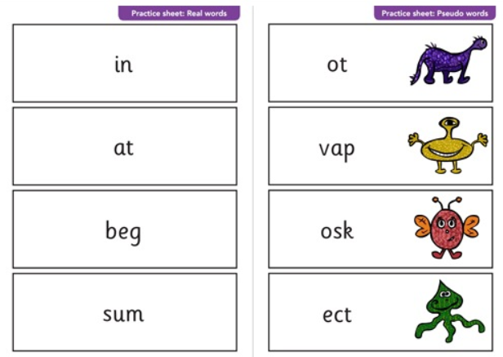

Slide 9
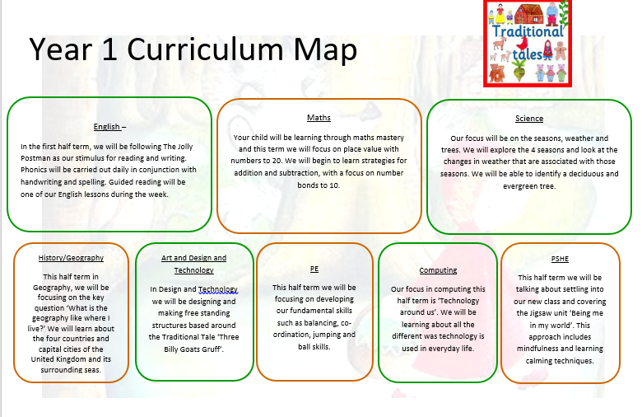
Curriculum Map and Age Related Expectations
  The current Year 1 curriculum maps and Age Related expectations are on the School website. Please visit them to refresh your memory as frequently as you would like.

Slide 10

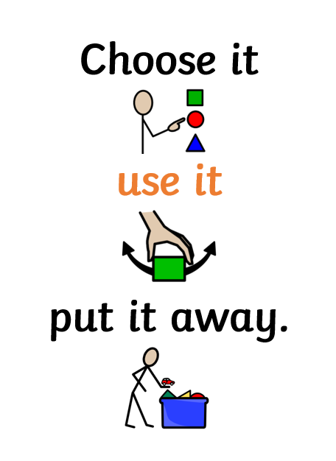

Slide 11

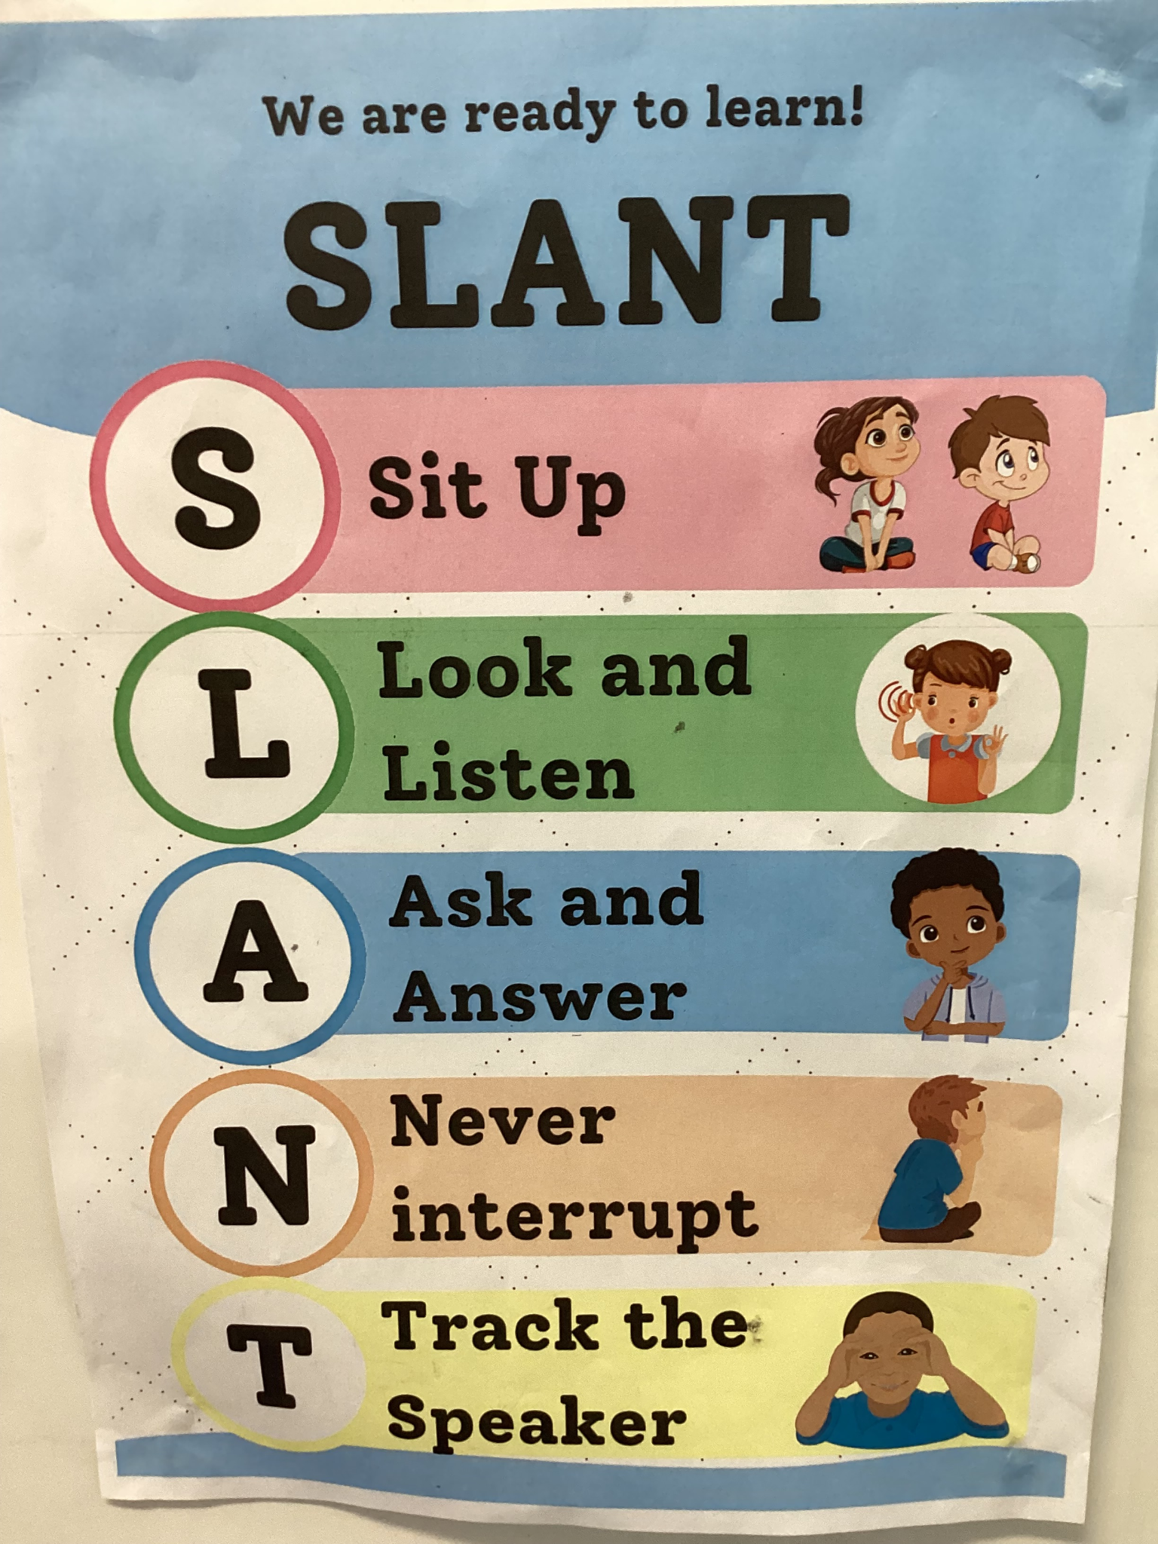
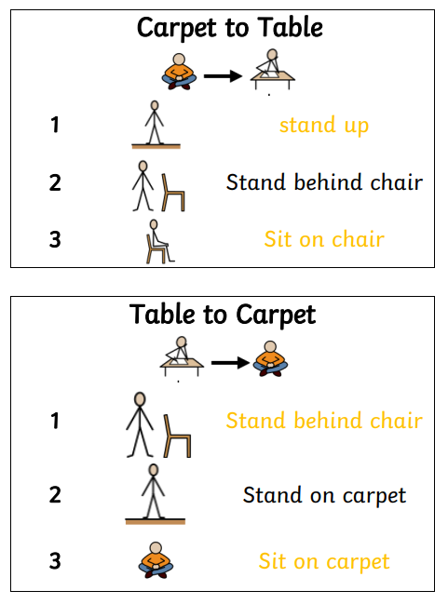

Slide 12
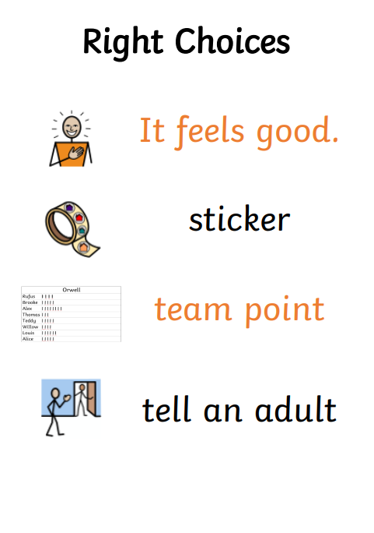
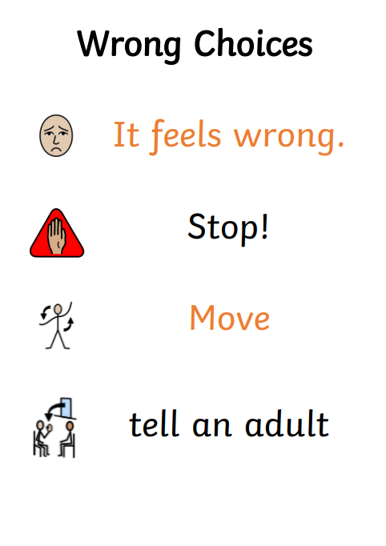

Slide 13
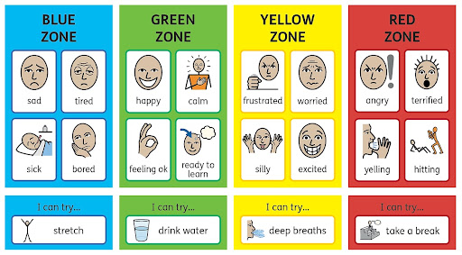
Zones of Regulation

Slide 14
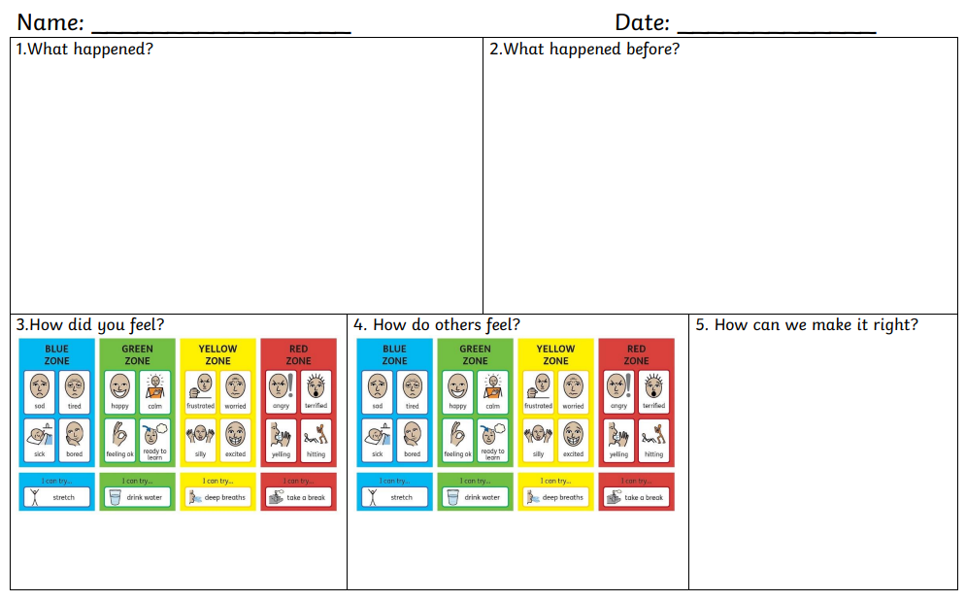

Slide 15

Questions
If you wish to contact the teacher, you can either phone the front office if it is of urgent attention or you can use the class emails:
Lions- lions@stmargaretsipswich.org
Tigers- tigers@stmargaretsipswich.org
Teachers will only respond in office hours and term time. For those queries of a non urgent nature, for example learning issues or friendship concerns it may take a couple of days for a response depending on the teacher’s availability.

